Slide 1
TASK1: EFFECTIVE METHODS AND OPPORTUNITIES FOR SOLVING PROBLEMS IN THE PUBLIC SERVICE
TASK 2: EXPLORE NEW INNOVATIVE WAYS TO MEET THE PUBLIC SERVICE CHALLENGES: WHAT MUST BE DISCARDED, KEPT, INTRODUCED AND EMBRACED

Slide 3
Key Performance Areas | Issues (problems & challenges) | Interventions (effective methods & opportunities for solving the problems) | What must be discarded/kept/ introduced & embraced)
Institutional Capacity & Administrative Capability | Appointments not on merit There is a general lack of Professionalism, and HR managers are central to the low morale of employees | Skills audit, Skills retention, and equipping of staff to perform 2. Senior managers to provide leadership and ensure HR issues such as PMDS amongst others are done properly and they should lead by example | 1. Discard popularity leadership 2. As senior managers we should model the outcome we require (be at work at 7:45 as the manager as you expect the staff to be at work 7:45) 3. Introduce IT such as Biometrics to ensure accountability & monitoring of personnel for consequence management
Notes:
----- Meeting Notes (2014/11/27 11:50) -----
why are we here
for who are we to serve, and
how to do it

Slide 4
Key Performance Areas | Issues | Interventions (effective methods & opportunities for solving the problems) | What must be discarded/kept/ introduced & embraced
Financial management | Audit Outcomes not linked to performance (expenditure not reflect the impact of service). Corruption Inefficient use of financial resources | 1. Audit outcomes to be aligned to impact of service delivery on communities 2. Senior Managers to lead in monitoring and managing fruitless and unauthorised expenditures in support of clean audit outcomes 3. Identify inefficiencies & enforce presrcipts (PFMA/MFMA) | 1. Mechanisms to evaluate both the audit outcome and service delivery. 2. A provincial task team to look at institutional development strengthen business processes on SCM 3. Use technological equipments for meetings & reporting
Notes:
----- Meeting Notes (2014/11/27 11:50) -----
why are we here
for who are we to serve, and
how to do it

Slide 5
Key Performance Areas | Issues | Interventions (effective methods & opportunities for solving the problems | What must be discarded/kept/ introduced & embraced)
Provision of services | Reactive planning of services Silo mentality where we plan sector based without sufficient collaboration | Be pro-active in our approaches and ensure IDPs are responsive to community needs for all sector programmes. Joint planning and participation by all sector depts in the IDP process. Strengthen the oversight structures of hospital/clinic management | Participation by way of nomination of municipal representative on structures like hospital board in order to have an in-depth appreciation
Notes:
----- Meeting Notes (2014/11/27 11:50) -----
why are we here
for who are we to serve, and
how to do it

Slide 6
Key Performance Areas | Issues | Interventions (effective methods & opportunities for solving the problems | What must be discarded/kept/ introduced & embraced)
Public participation | 1. Superficial public participation for compliance purposes | Ensure Functional Ward Committees that: implement ward operational plans in full, convene ward and community meetings, Hold feedback sessions to communities, submit and table monthly ward committee reports to communities. | 1. Introduce performance assessment scorecards to measure, evaluate and monitor the impact of service delivery and the functionality of ward committees 2. Strengthen the citizen’s fora role and community activism at ward level to hold officials accountable for service delivery (PSC)
Notes:
----- Meeting Notes (2014/11/27 11:50) -----
why are we here
for who are we to serve, and
how to do it

Slide 7
Key Performance Areas | Issues | Interventions (effective methods & opportunities for solving the problems) | What must be discarded/kept/ introduced & embraced
Good Governance | 1. Effectiveness of IGR forums at all levels 2. Ineffective oversight structures in holding officials to account 3. Uncommitted officials | Promote intersectoral collaboration that will ensure productivity and alignment of systems (CRDP model and OSS from KZN) Strengthening of the oversight structures to monitor effective implementation of government services to the people Senior Managers to take responsibility for their work and make service excellence our way of life (habit)
Notes:
----- Meeting Notes (2014/11/27 11:50) -----
why are we here
for who are we to serve, and
how to do it

Slide 8
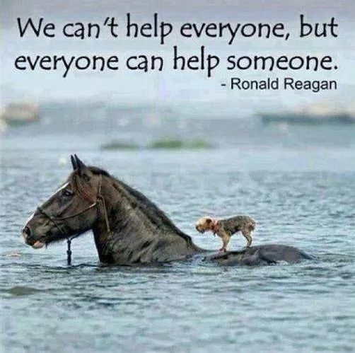

Slide 9
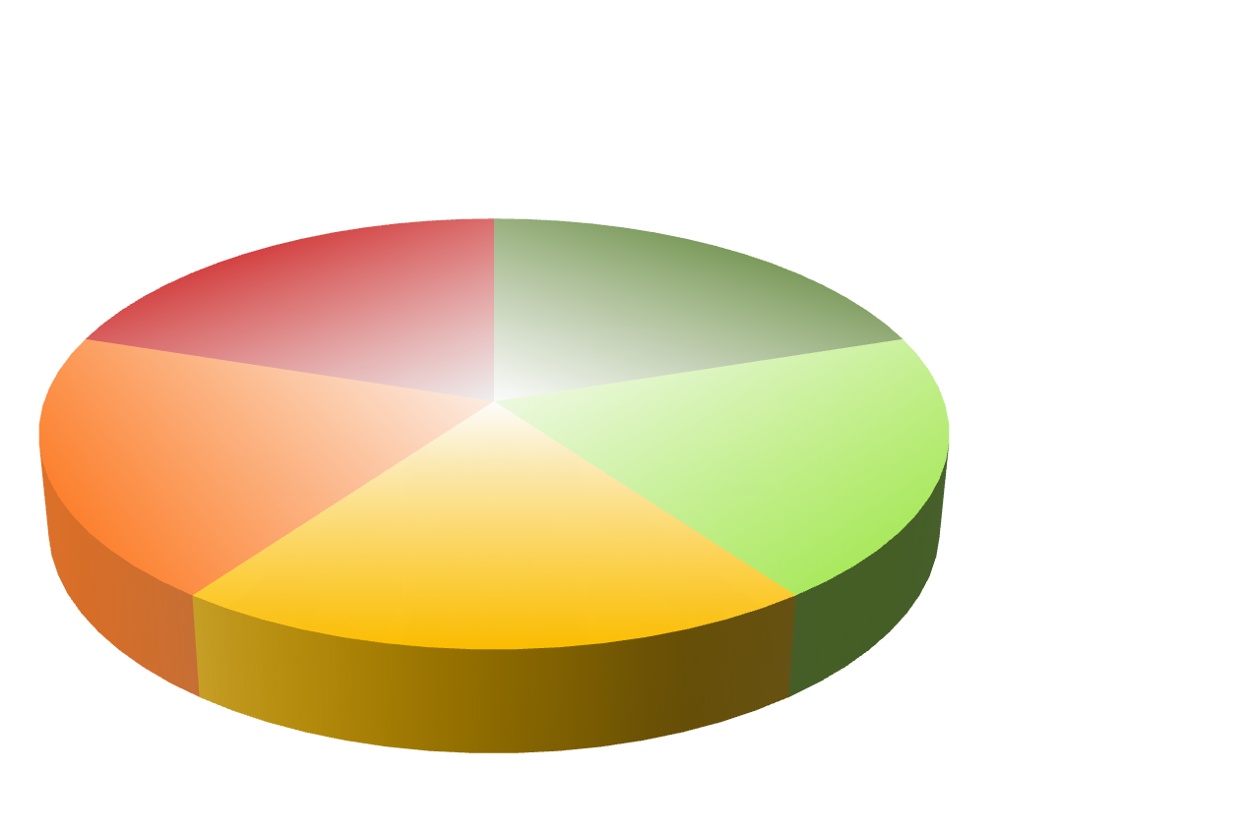
Thank You

