Slide 1
Innovation in South Africa Mrs Kgatliso Hamilton, Centre for Public Service Innovation (CPSI) South Africa 26 November 2014

Slide 2
South Africa Today
“In the February State of the Nation Address, I related the good story of 20 years of freedom and democracy. We stated that South Africa is a much better place to live in than it was in 1994, and that the lives of millions of our people have improved.
However, as the National Development Plan and the Presidency Twenty Year Review highlight, the triple challenges of poverty, inequality and unemployment continue to affect the lives of many people.” SONA 2014

Slide 3
About the CPSI
A Government Component - ‘lean’ government entity with single mandate reporting to the Minister for Public Service and Administration
The Public Service Act mandates the Minister to drive innovation in the public service:
Minister is “responsible for establishing norms and standards relating to transformation, reform, innovation and any other matter, to improve the effectiveness and efficiency of the public service and its service delivery to the public”.
Public Service Act of 1994 as amended in 2007
It is therefore a facility of government with public sector wide reach, established to entrench and drive the culture and practice of innovation in the Public Service in response to identified challenges in support of government’s priorities

Slide 4
The role/mandate & work streams of CPSI
Unearthing, encouraging, rewarding showcasing, piloting & facilitate the mainstreaming innovation in the public sector

Slide 5
Model
Finding or developing innovations & promoting replication
Culture & practice of innovation entrenched
Projects
MMIC
Platforms & Products

Slide 6
Approach
Work in partnership with sectors to identify challenges relating to government priorities
Set up integrated stakeholder teams to interrogate the challenge, explore innovative solutions to improve service delivery and funding model (CPSI does not own a service)
Oversee testing and piloting – ensure in line with government legislation whilst challenging outdated rules and regulations
Ensure ownership is appropriately allocated for mainstreaming, sustainability & IP protection
Facilitate sharing of knowledge on innovative approaches and solutions to avoid re-inventing of the wheel
Facilitate & support replication

Slide 7
Instruments and Mechanisms
Multi-Media Innovation Centre - Access to and sharing of international innovative practices
12 Years of Annual Innovation Awards (including entry into international Awards such as the UN Pubic Service Awards, AAPSIA, CAPAM)
Knowledge Sharing Platforms and Products
Demonstrator Pilot Projects and Replication Projects
Training Course
Notes:
As the CPSI and as a country we have put a number of instruments in place to promote the culture and practice of innovation. These include the following which will be expanded on in the next slides:

Slide 8
Multi-Media Innovation Centre
A content driven exhibition and decision-support centre (walk-in facility) with various multi-media platforms for learning, demonstrating innovation and planning
Space and a platform for public servants to interrogate their specific challenges, and explore and incubate solutions away from their offices and environments
Demonstrate content at exhibitions / conferences
Next phase – virtual innovation centre

Slide 9
The CPSI Public Sector Innovation Awards as feeder into Repository
Established in 2003 to recognise & reward innovation in the public sector
Promotes unearthing, sharing and replication of innovative practices
Celebrates the successes of individuals, teams, municipalities, national and provincial departments and other institutions.
Feeds into the CPSI replication programme.
Important: Winners and finalists become “champions and ambassadors”, i.e. supporting others in replicating

Slide 10
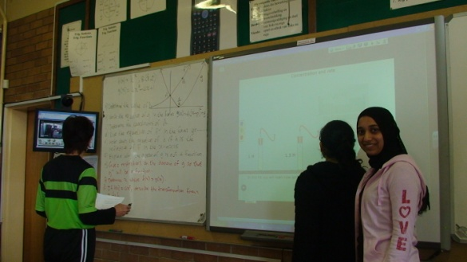
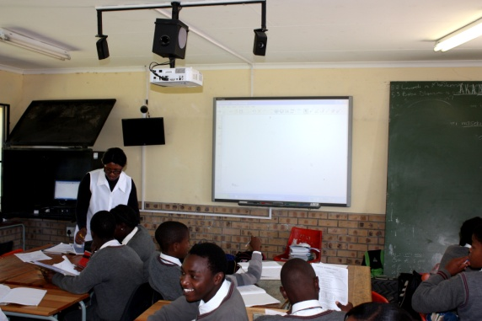
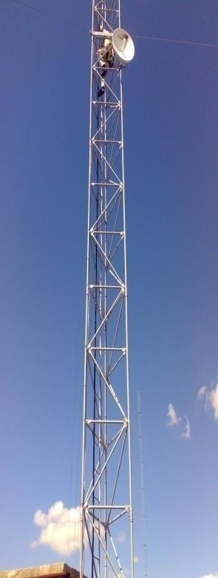
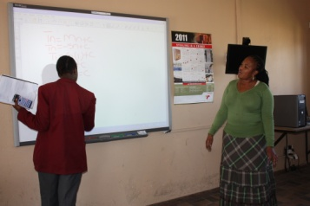
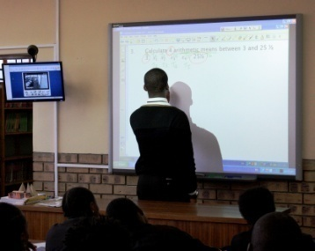
CPSI Awards Winner 2012
1. LIGBRON
6. Ithafa
10km
2. Ermelo Combined
5. Masizakhe
7km
50km
30km
23km
3. Umzimvelo
4. Camden Combined

Slide 11
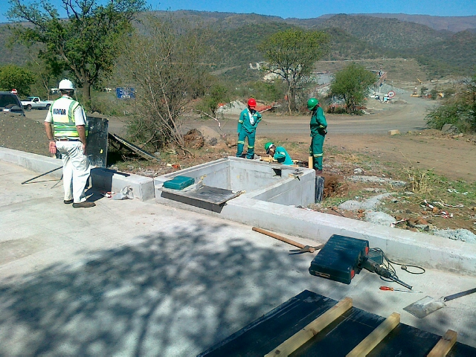
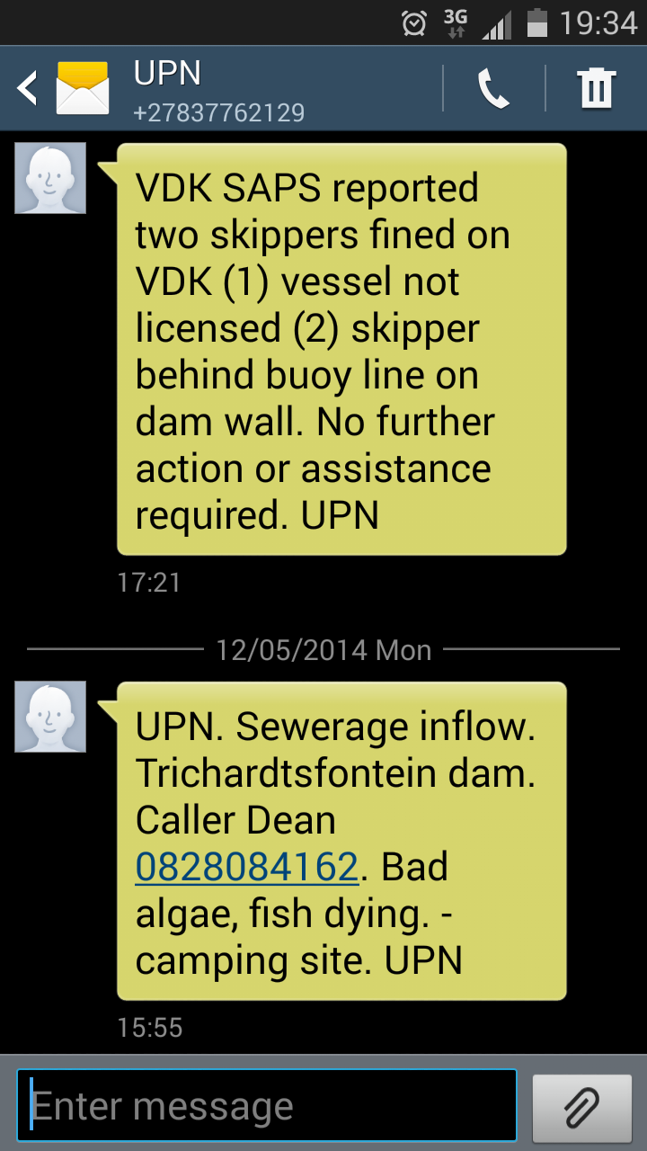
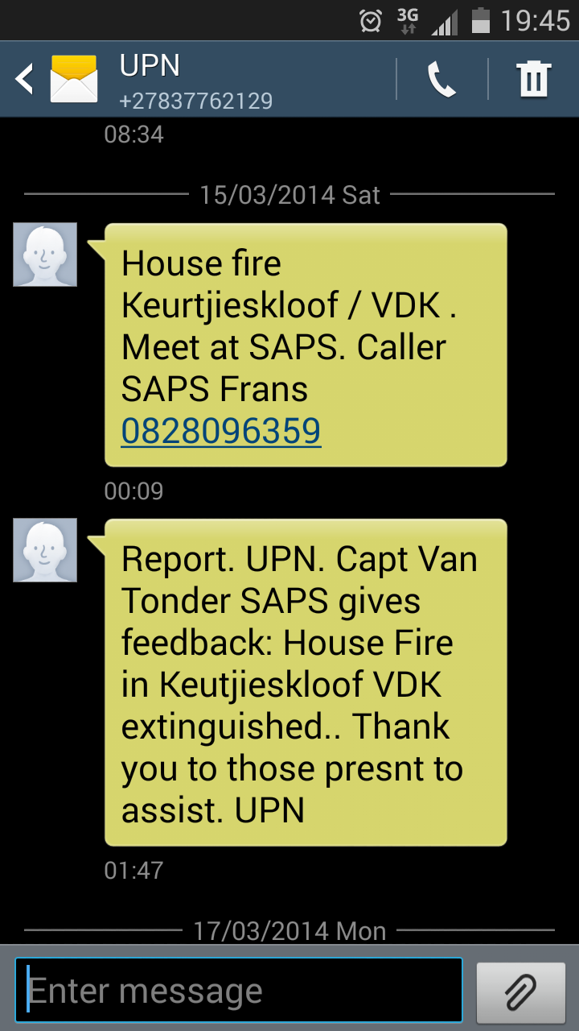
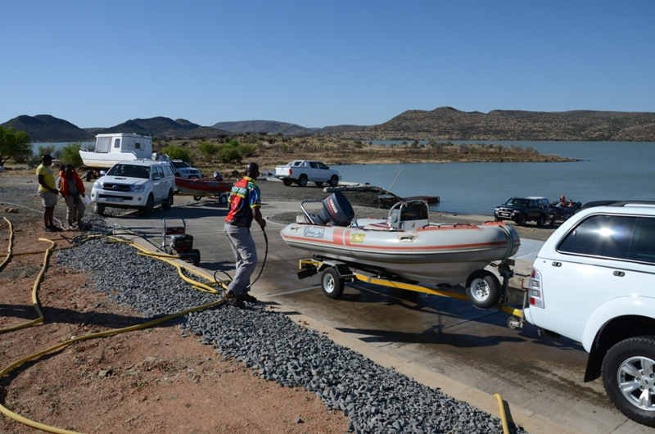
New Pilot Projects –
from concept to prototype
Cooperative Inland Water Safety
and integrity
Notes:
In many cases departments approach the CPSI or we identify critical challenges. We then drive projects where solutions to these challenges are interogated and testing and piloting done to develop working prototypes / models for further replication. Two examples of current projects are the Cooperative inland waterways safety project and thedevelopment of a dashboard for the Honeydew Policing Cluster Nerve Centre

Slide 12
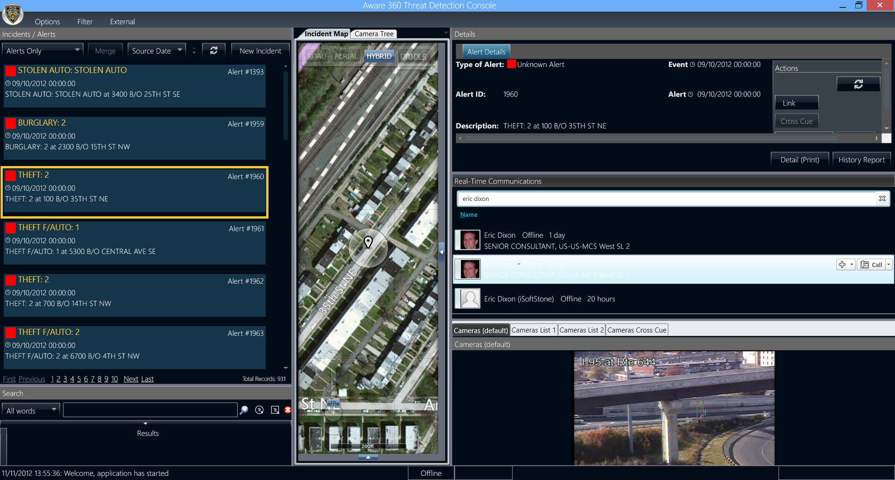
New Pilot Projects –
from concept to prototype (2)
Development of new real-time policing nerve centre
Integrating existing systems & CCTV cameras into a single view

Slide 13
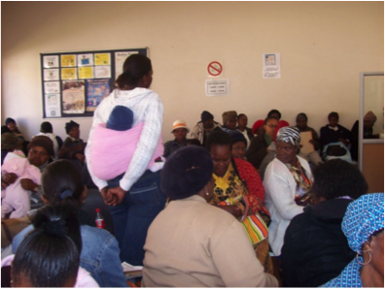
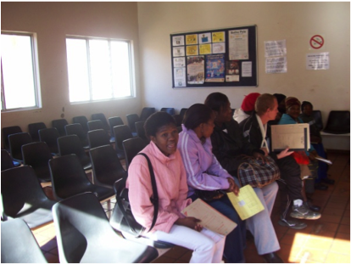
Replicating Innovative Projects
Facilitating engagements amongst institutions grappling with the same challenges, e.g. Improving internal efficiencies in hospital pharmacies through sharing of innovative practices.

Slide 14
Knowledge Platforms and Products
South African Public Sector Innovation Journal Ideas that Work
Easy to read case studies, insights, also international insights and Future Watch articles
Annual Public Sector Innovation Conference
Primary networking session to share and replicate
Publishing Case studies
In-depth studies for possible
replication

Slide 15
International Innovation Community
UNPAN (United Nations Public Administration Network Portal)
CPSI 1 of 20 Innovation Teams (Nesta & Bloomberg 2014)
Three rounds of AAPSIA (All Africa Public Sector Innovation Awards)
UN Expert Group on Replication innovation in LDCs (Least Developed Countries)
OECD Observatory on Public Sector Innovation
Co-publishing with CAPAM

Slide 16
Challenges
Funding for Innovation – two edged sword
Replication of Innovations
Infrastructure (KZN Teleradiology)
Senior Management Buy-in

Slide 17
Conclusion
Innovation does not have to be big – Jojo Tanks project highlights the essence of Innovation
Don’t let challenges stop or inhibit you
It always seems impossible until its done. Nelson Mandela

Slide 18
Thank you

