Slide 1

Primary Animal Health Project
SMS SUMMIT: 27 NOVEMBER 2014
WHITE RIVER, MPUMALANGA MAGADLA, N
GAUTENG VETERINARY SERVICES

Slide 2
INTRODUCTION
Mainly urban with rural constituency of approximately 4%
Livestock keepers range from backyard (townships, informal settlements, mining areas) to formal
Mainly home production for home consumption (income generation or movement of animals to the owner’s home provinces)
Limited number in formal agricultural land

Slide 3
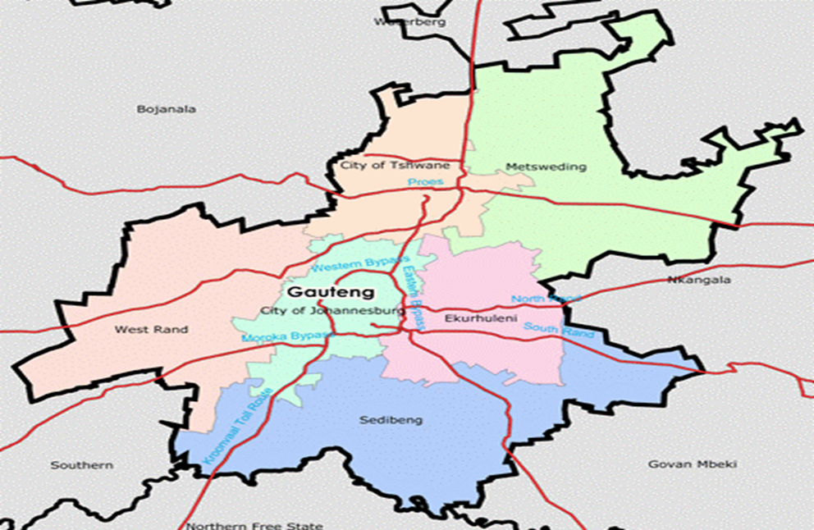
AGRICULTURAL HOUSEHOLD DISTRIBUTION
Income expenditure survey /Labour force survey 2000
1
3
3
4
3
2

Slide 4
WHAT ARE WE TRYING TO ACHIEVE?
Animal production vs. field crops & horticulture output ranges between 41 – 49% of agricultural output
Nearly 80% of agricultural land in South Africa is mainly suitable for extensive livestock farming
=> The livestock industry is the largest contributor to the national agricultural sector’s output, we need to demonstrate that we are capable of unlocking the potential that lies in the emerging sector

Slide 5
Assist our people
  Recognise, realise and maximise the resources they have so that they can realise their freedom
When is freedom realised???
  The only time is when we no longer depend on the State but contribute towards advancement of the State
  Fully utilize the support they never thought they have towards commercializing their production systems

Slide 6
KEY AREAS
Preventive Animal Health
Holistic Pet Care
Veterinary Awareness

Slide 7
Veterinary Awareness

Slide 8

Veterinary Awareness

Slide 9
PREVENTIVE ANIMAL HEALTH
Livestock vaccinations
  Lumpy Skin Disease
  Pulpy Kidney
  Anthrax, Black Quarter and Botulism
Parasite treatments
  Ivermectins
  Oral dewormers
  Pour-on
Traceability tagging

Slide 10
World Veterinary Day
26 April 2013
  Zoetis – Valbazen/ Valbantel
  GMPBasic – assisted with ear-tagging
  OBP, MSD,
  UP/OP – Preclinical year – technical skills
  GDARD officials – leading the groups
  Farmers – provided transport to farms
  DRDLR

Slide 11
DRDLR
Fencing
Handling Facilities
Boreholes

Slide 12
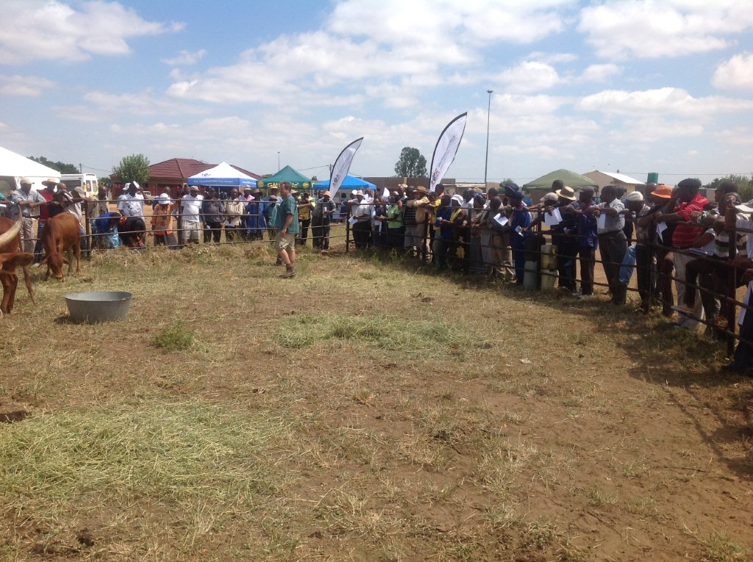
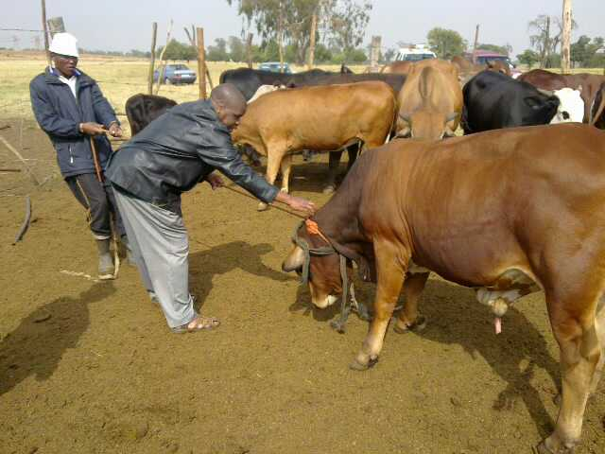
Practical

Slide 13
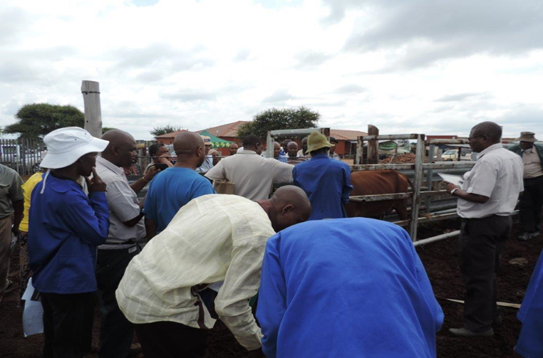
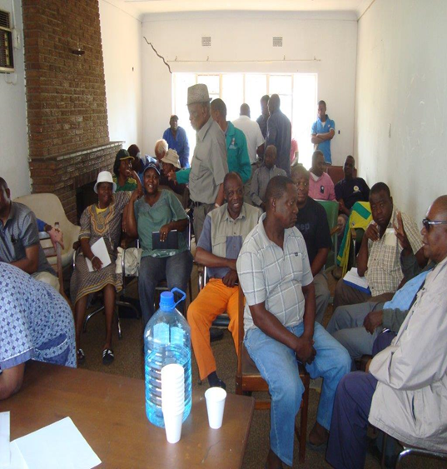
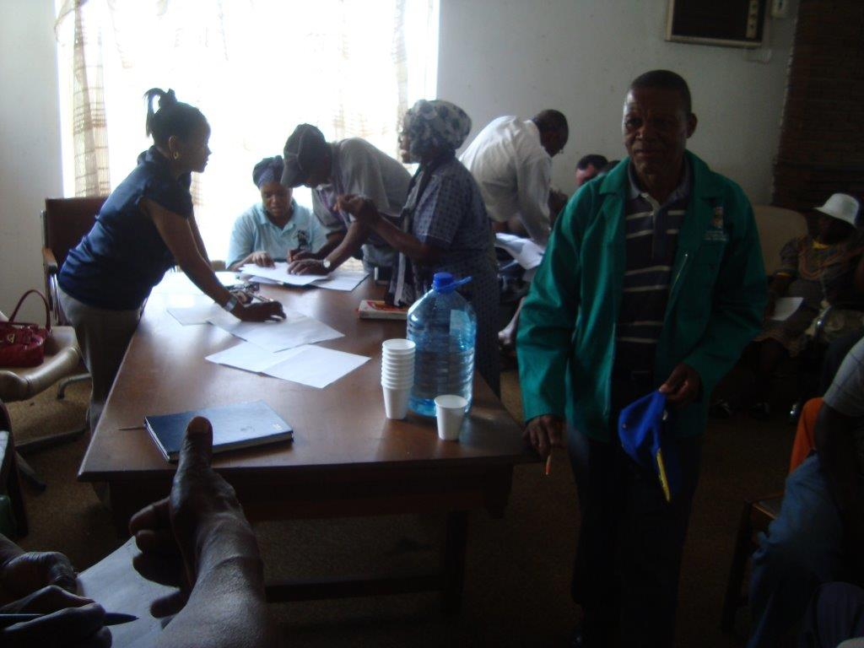
Farmer Participation

Slide 14
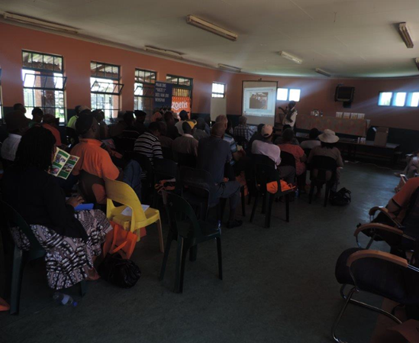
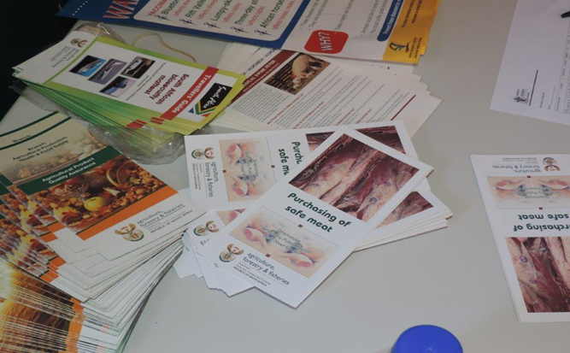
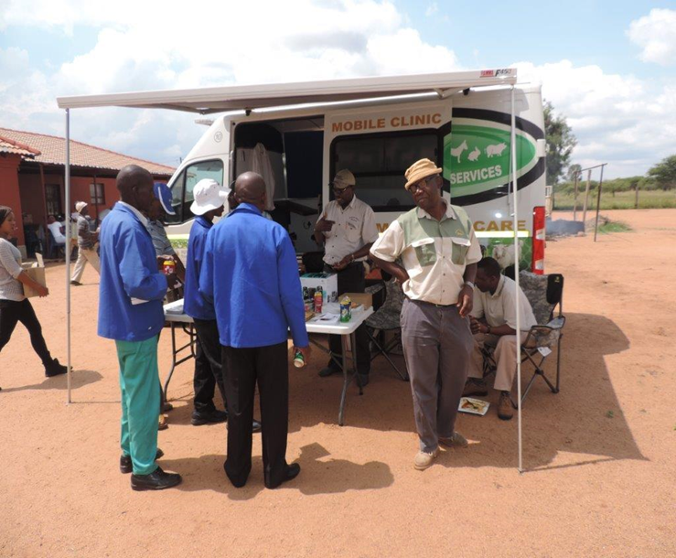
Knowledge transfer

Slide 15
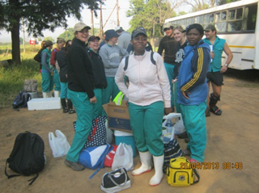
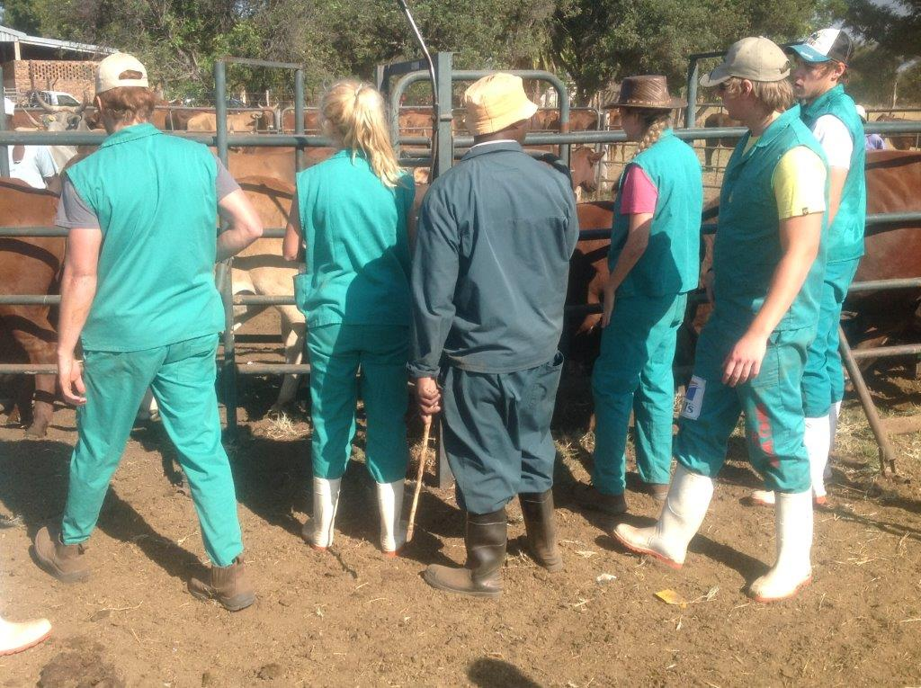
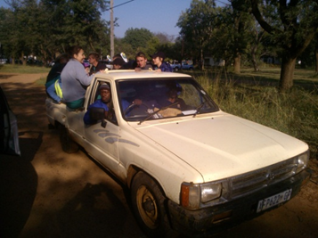
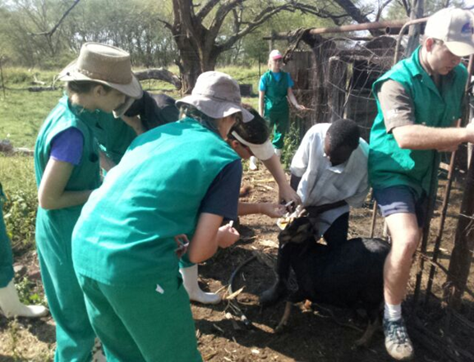
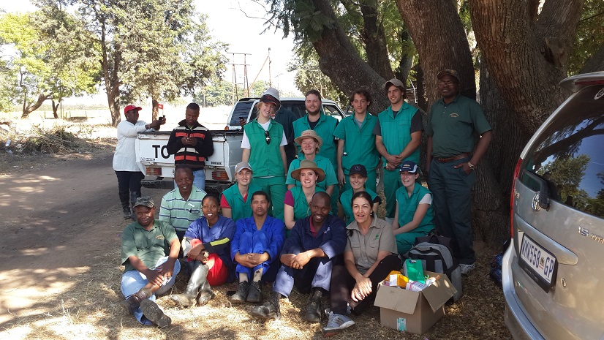
Involve Stakeholders

Slide 16
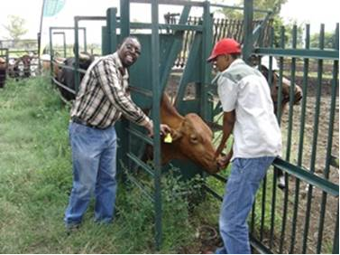
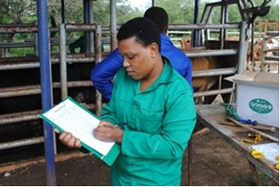
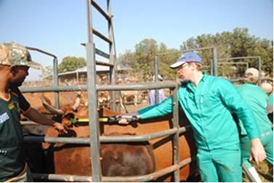
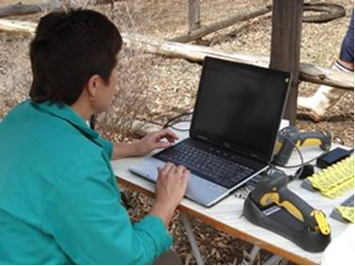
Animal Ear Tagging Process

Slide 17
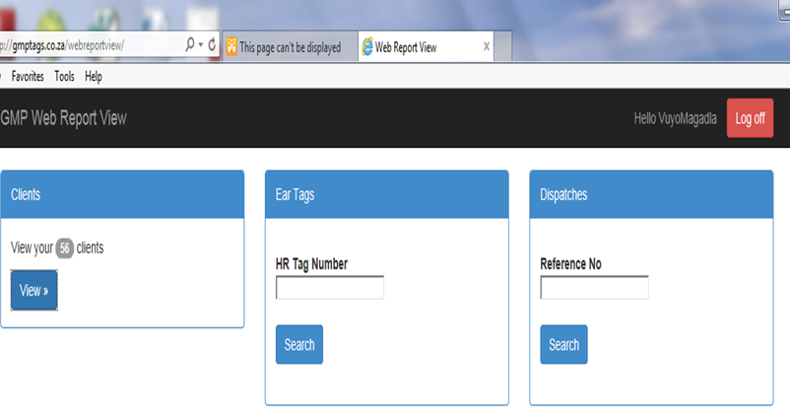
Dispatch Process

Slide 18
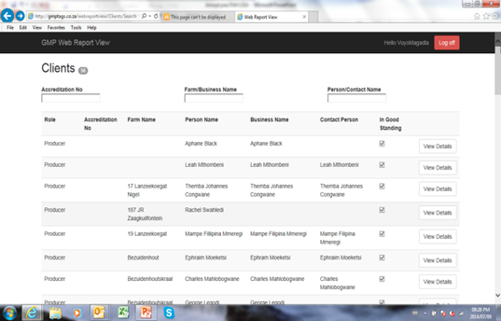

Slide 19
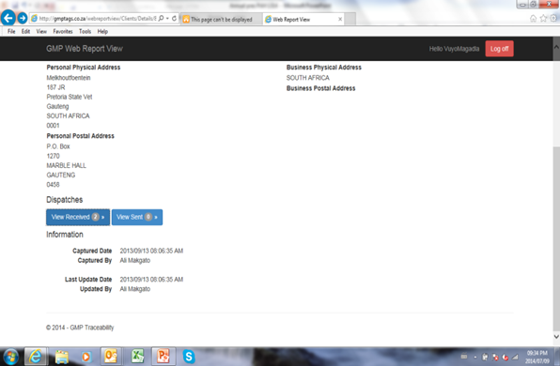

Slide 20
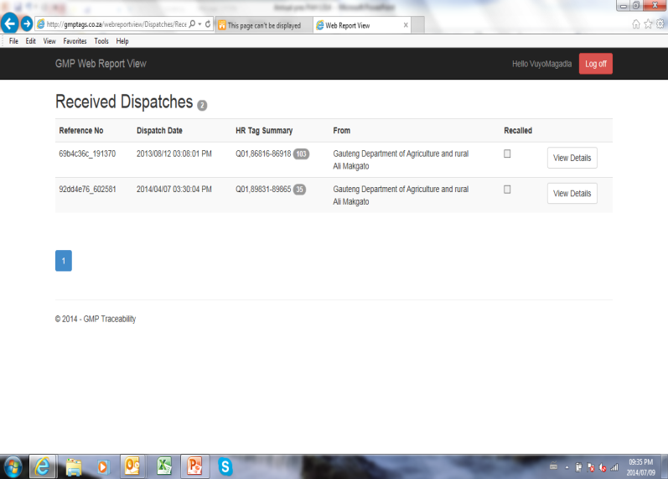

Slide 21
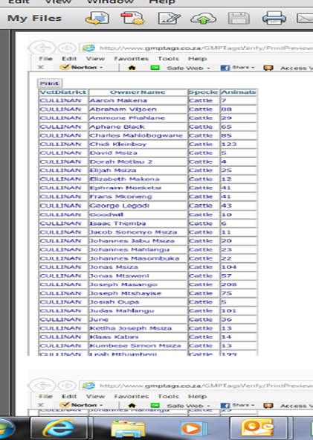
Traceability

Slide 22
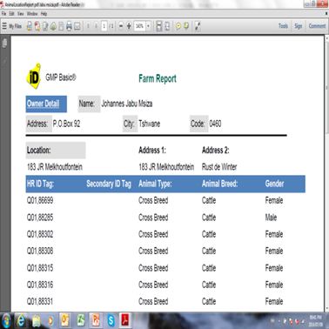

Slide 23
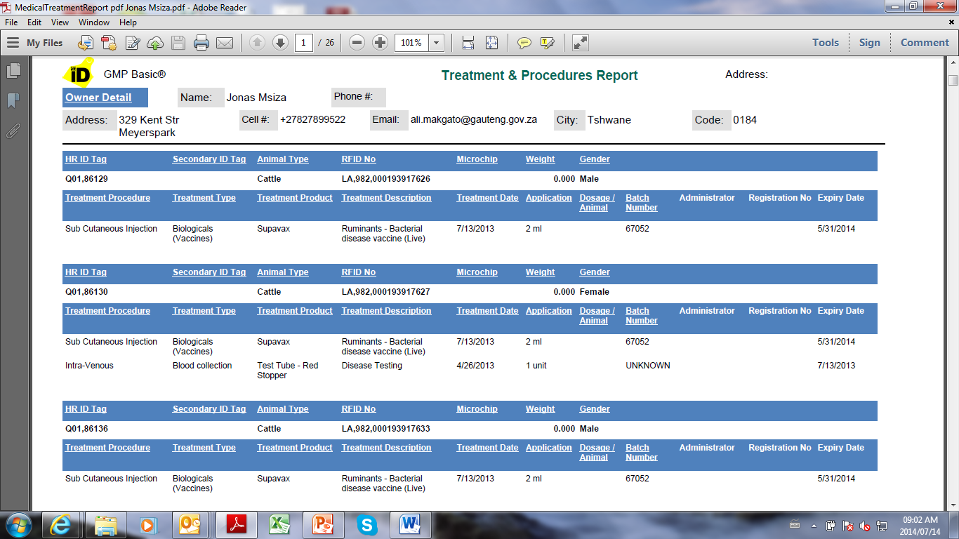

Slide 24
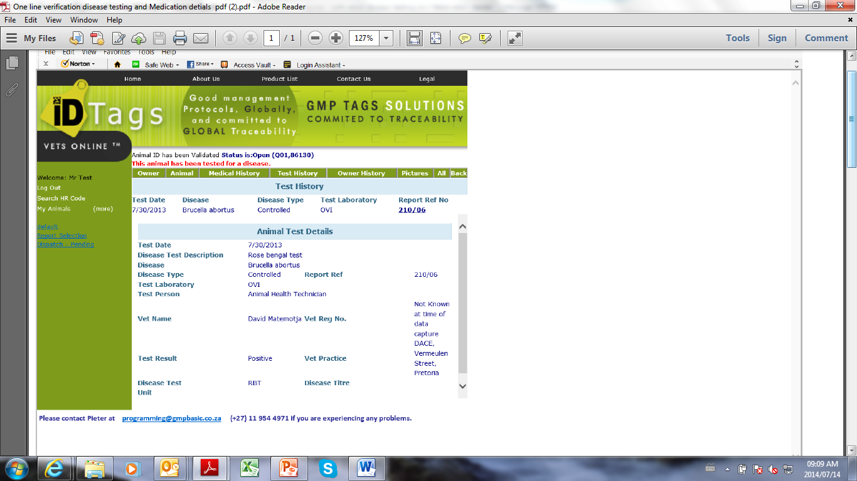

Slide 25


Slide 26
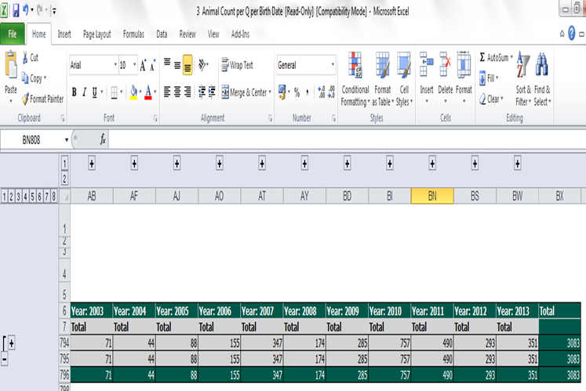

Slide 27
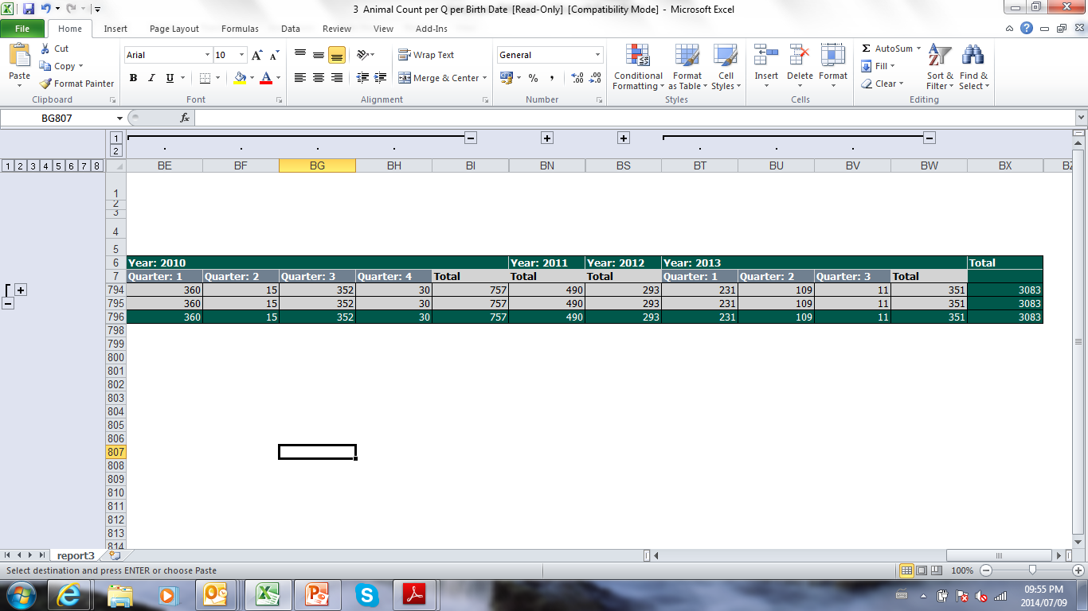

Slide 28
Benefits of Animal ID and Traceability System
Backward and Forward Tracing of movement of animals
  70% of new emerging infectious diseases are zoonotic
  Product tracking through value chain
Breeding Management and record keeping
Stock theft investigations

Slide 29
Extension of use of Traceability system in the SA
National at the FMD area – Visual Tags
Ostrich Industry – EU Exports
Northern Cape

Slide 30
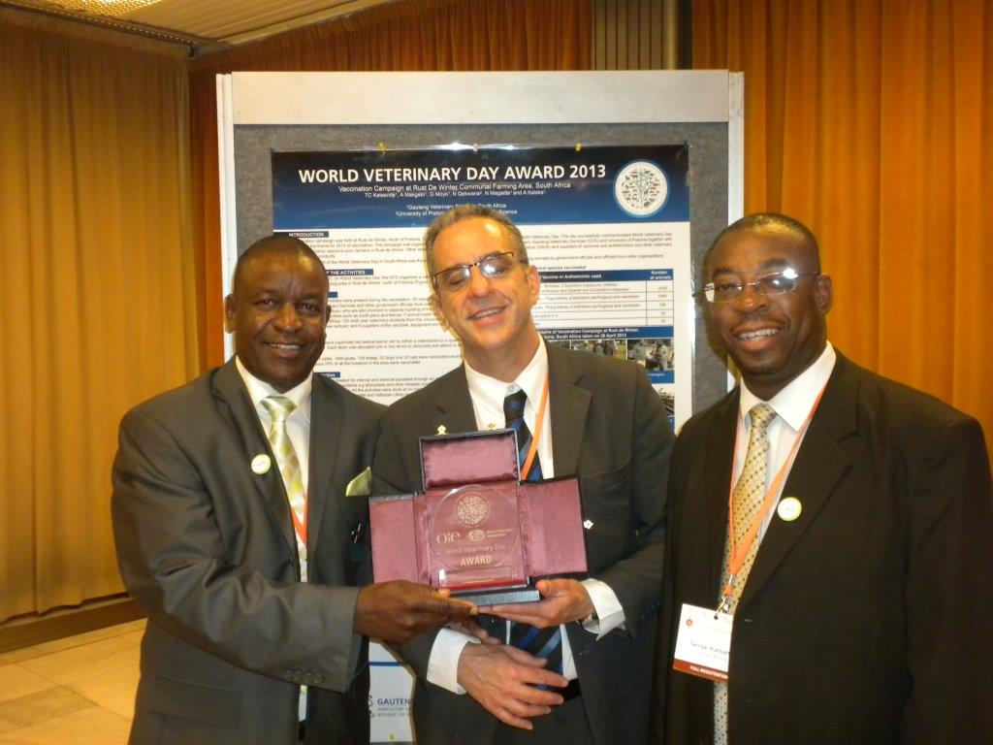

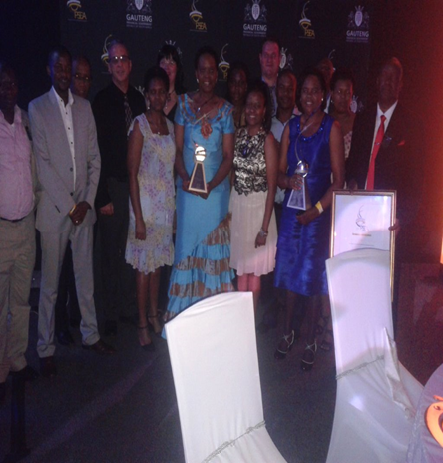
Local and International Recognition

Slide 31
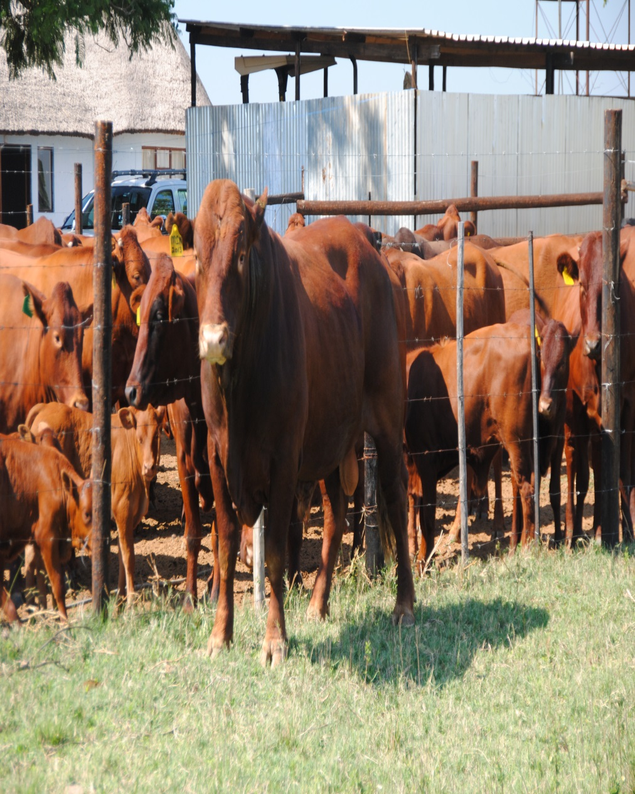
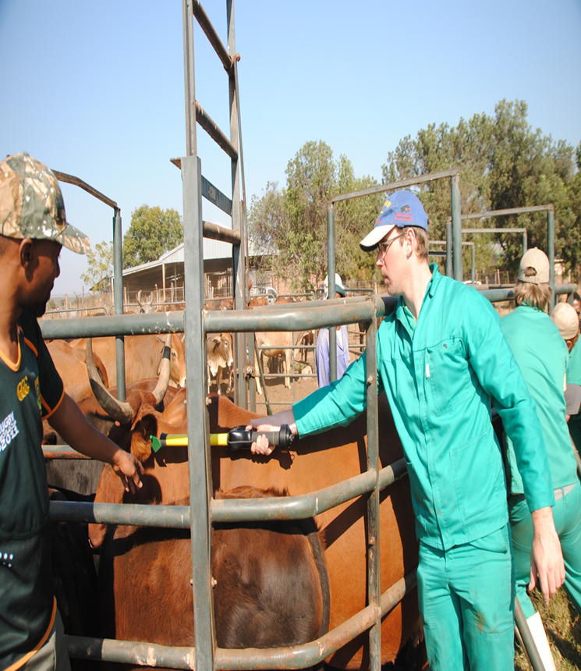
ELECTRONIC READING OF PREVIOUSLY TAGGED ANIMALS

Slide 32
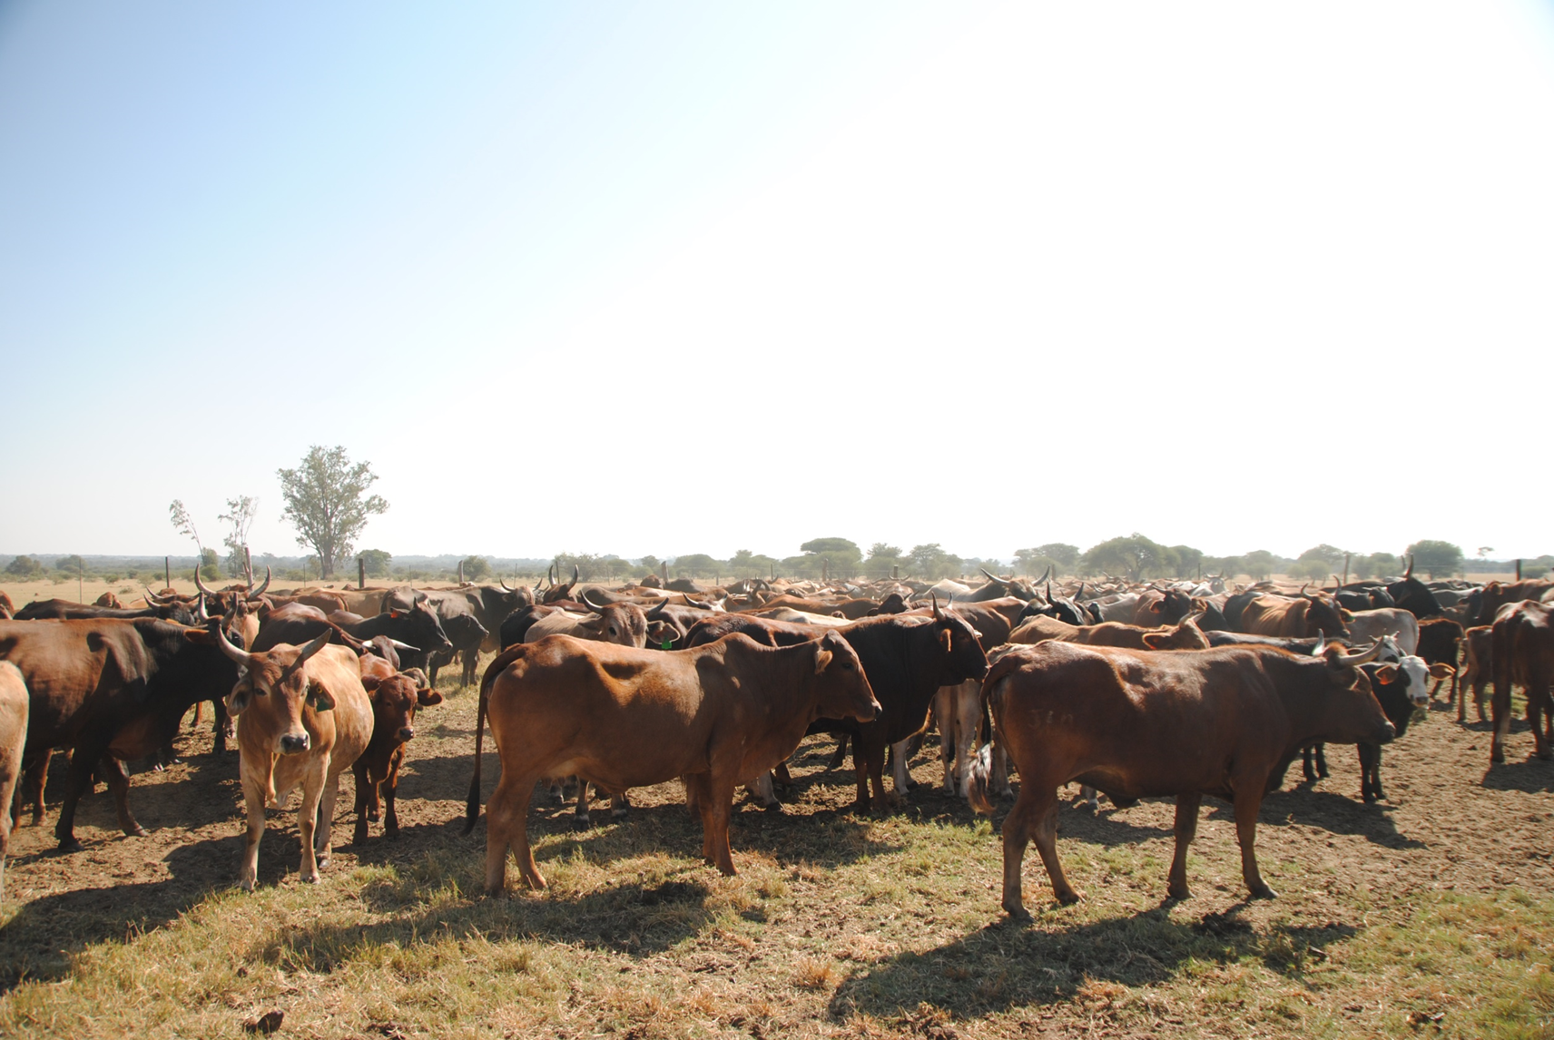
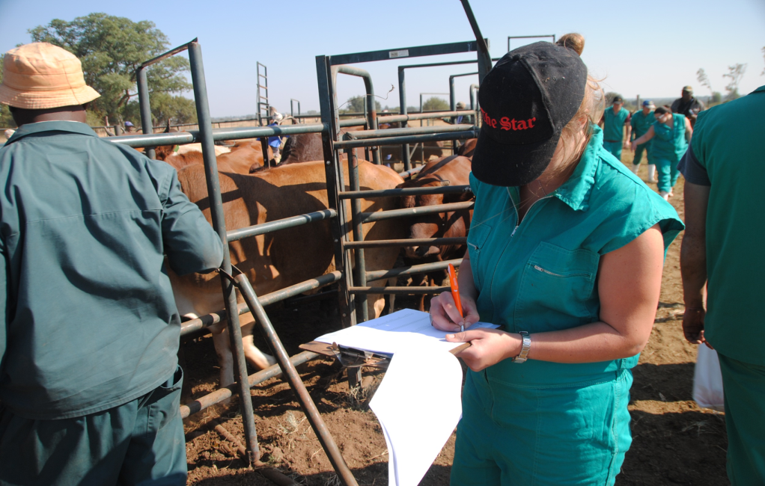
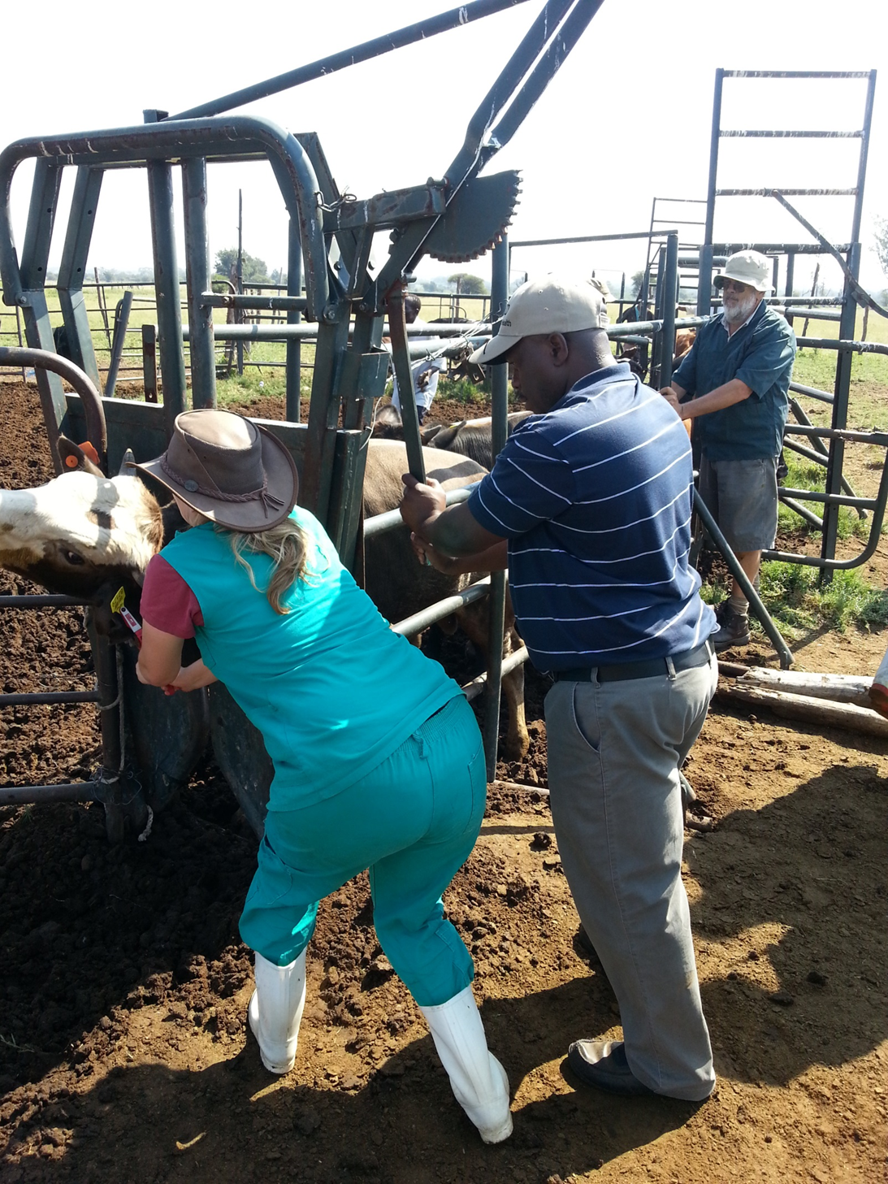
CONTINUE WITH ELECTRONIC TAGGING IN other areas

Slide 33
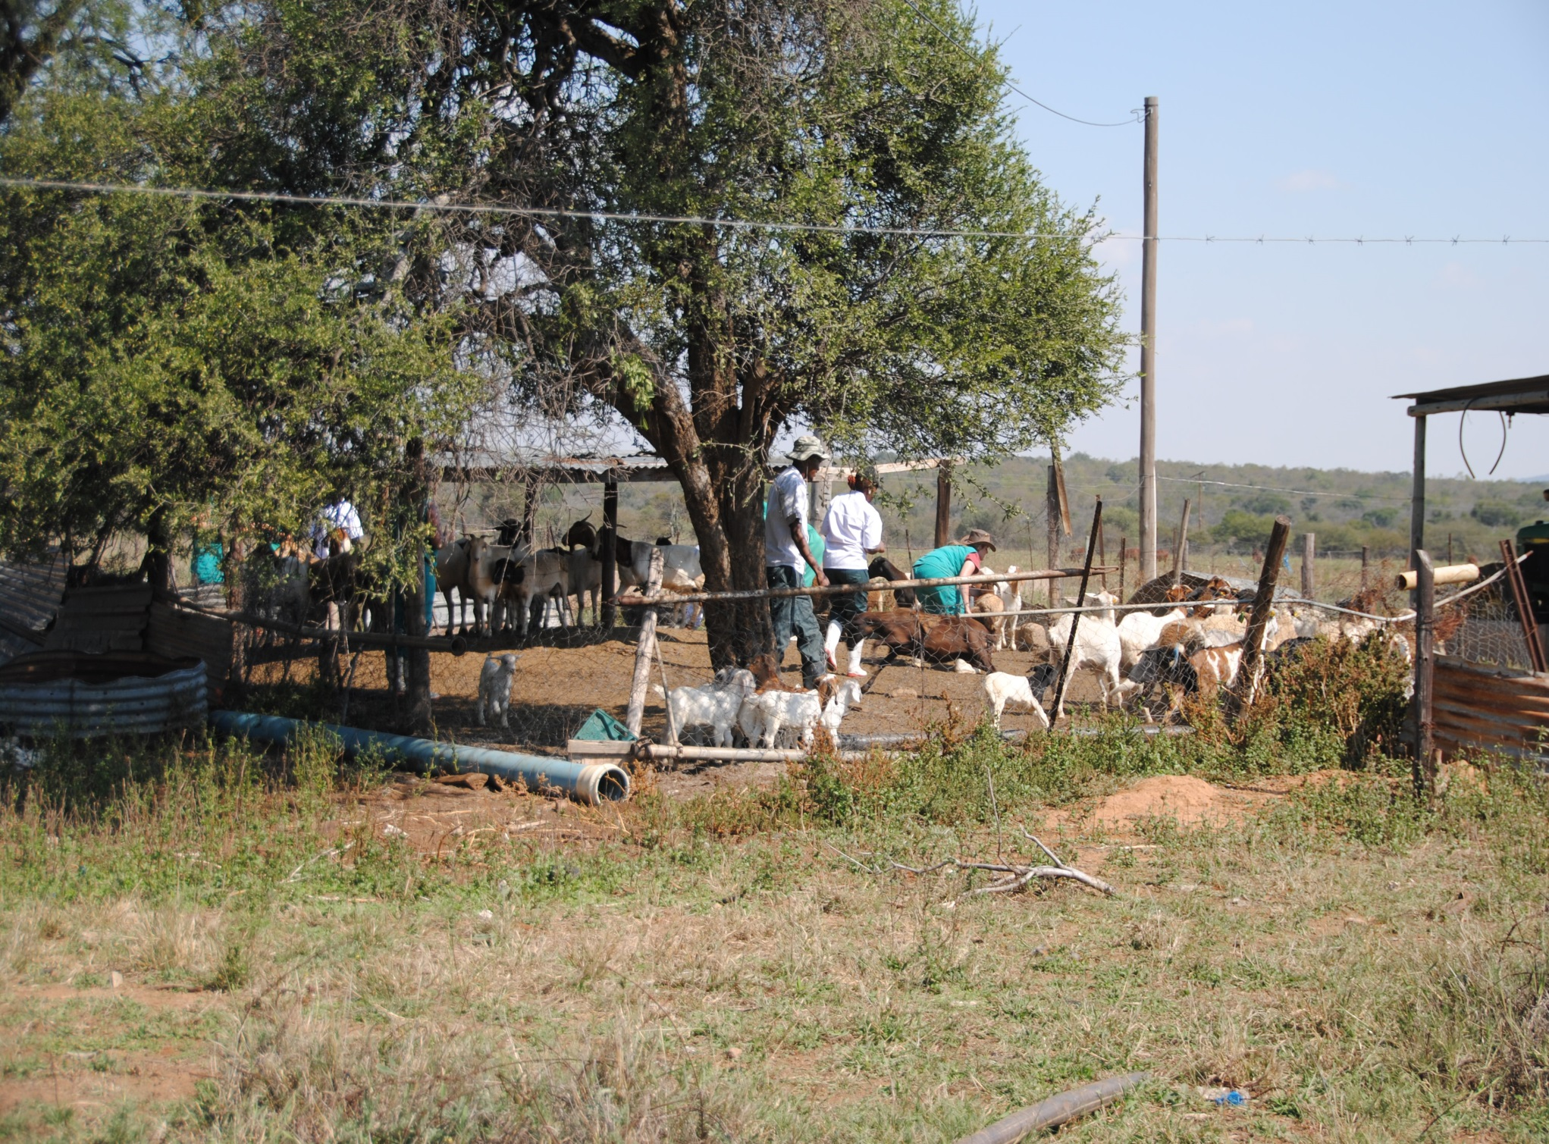
Small Stock tagging

Slide 34
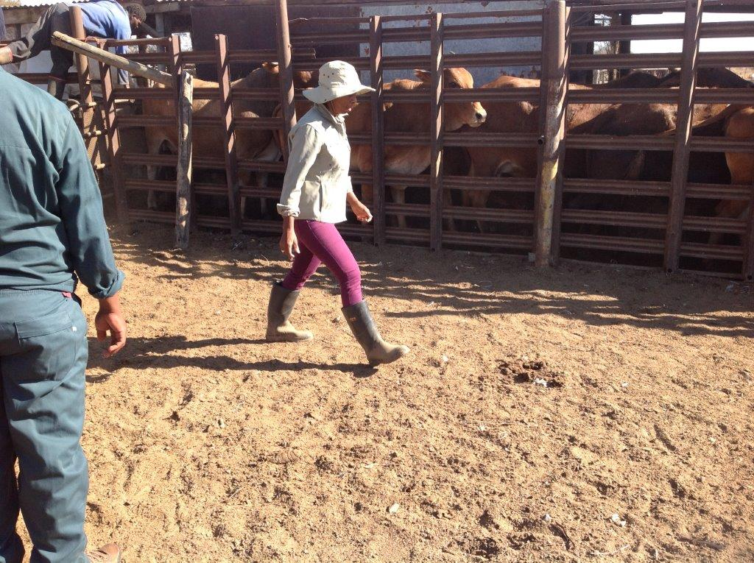
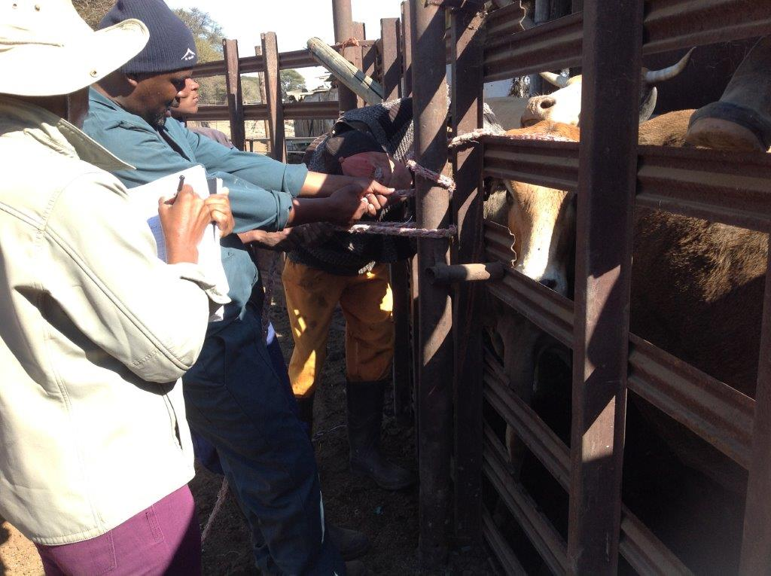
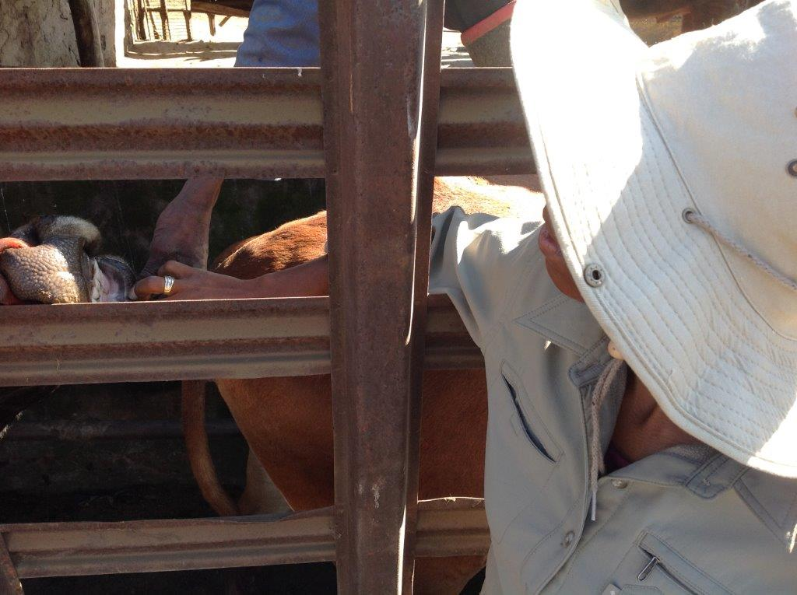
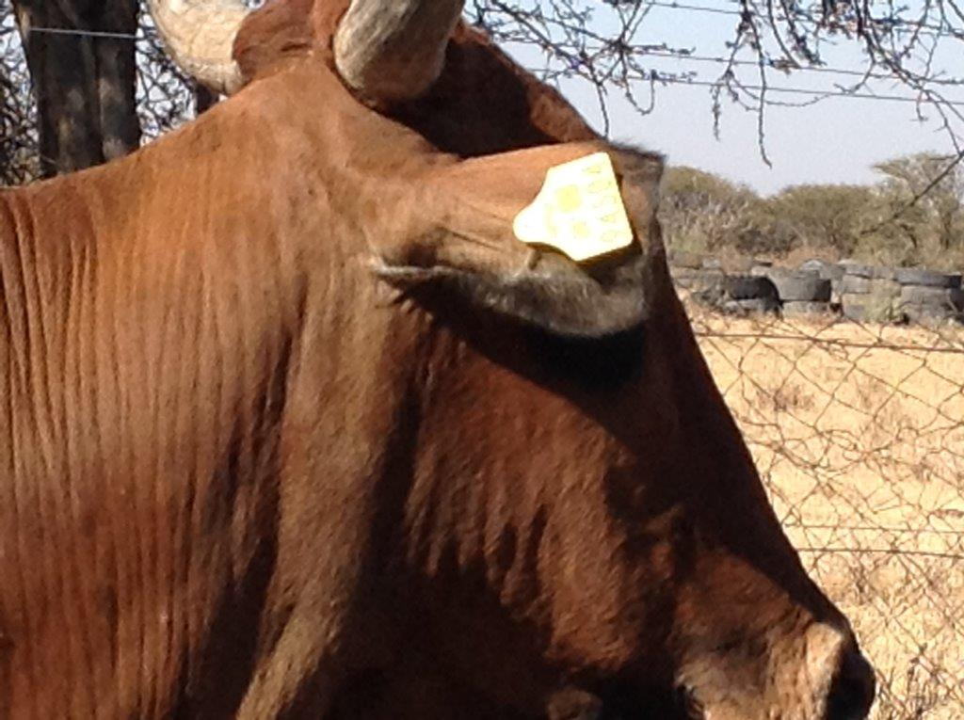
Individual Farmer training

Slide 35
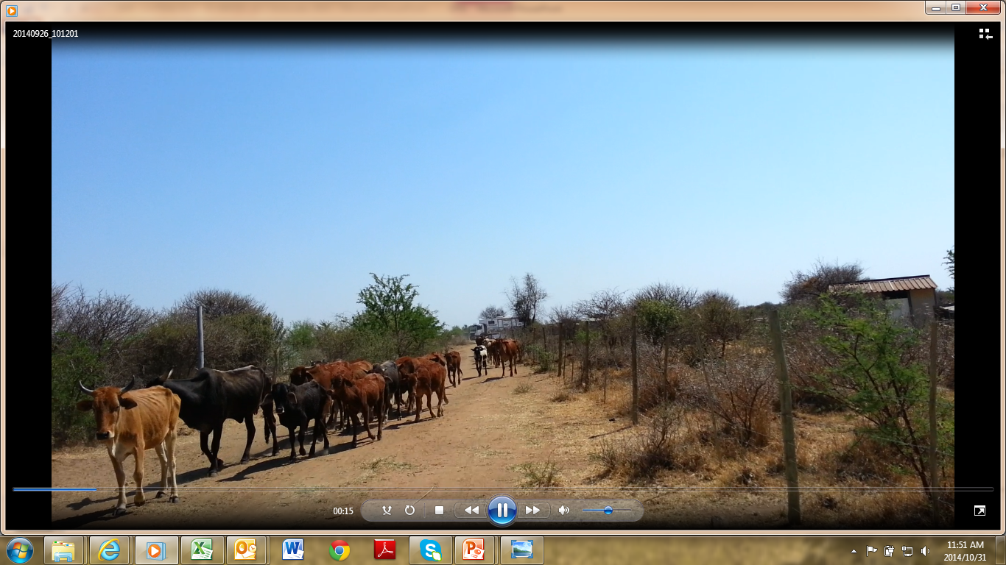
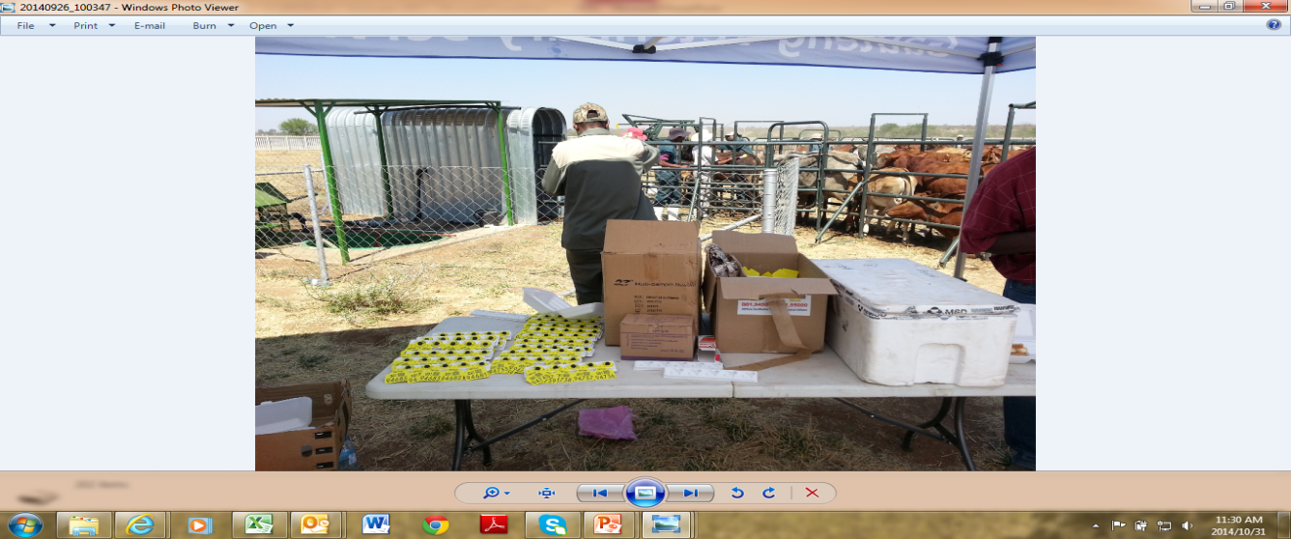
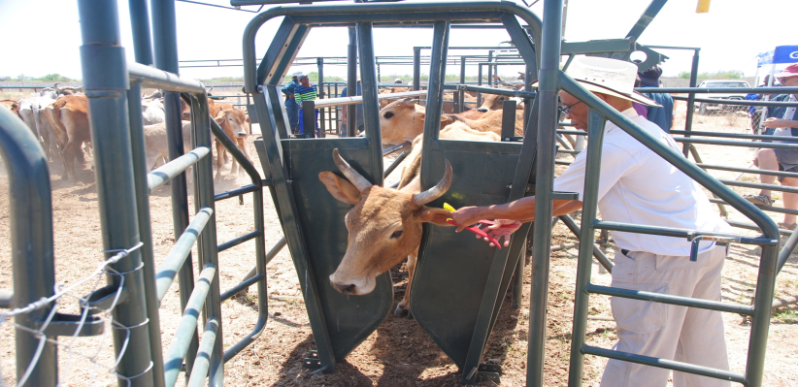
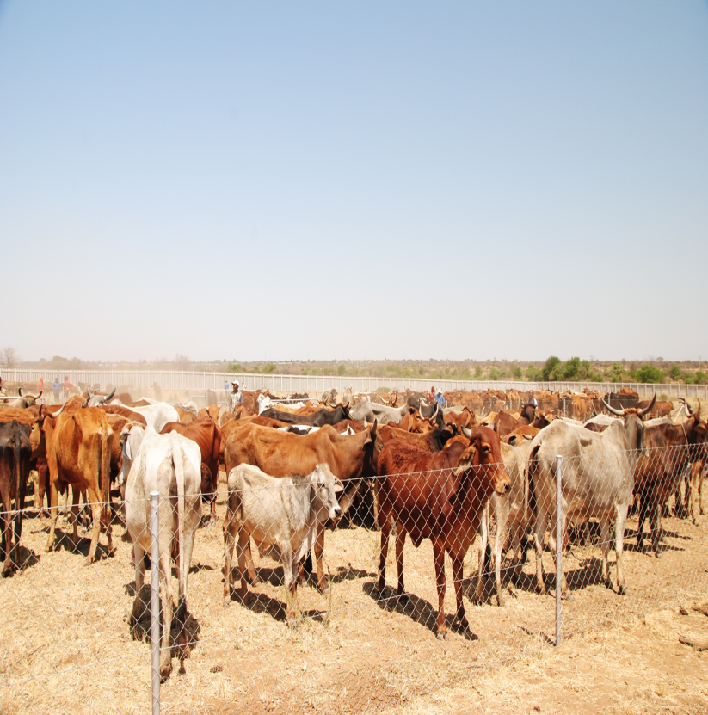
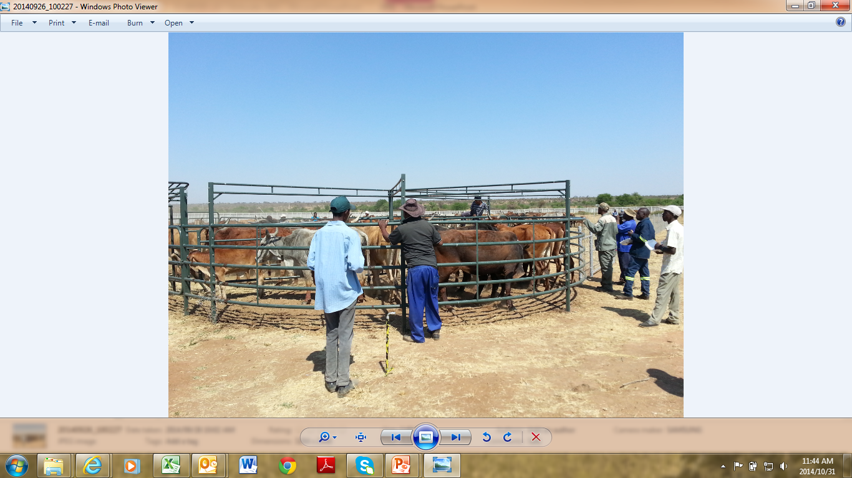
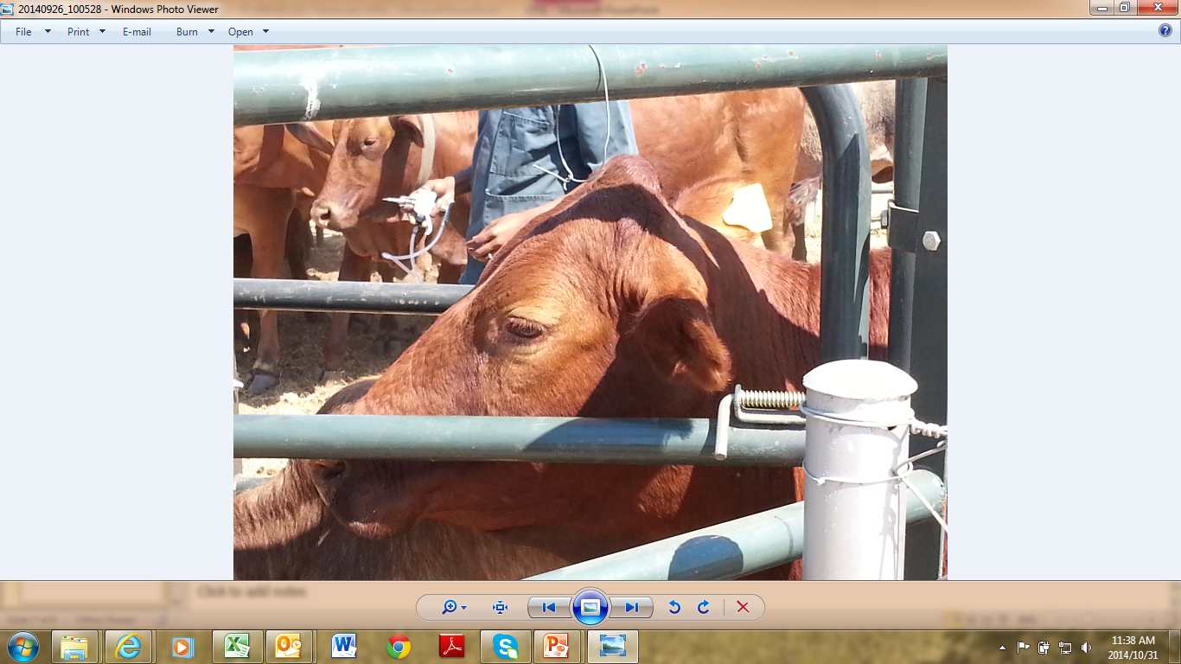
STINKWATER

Slide 36
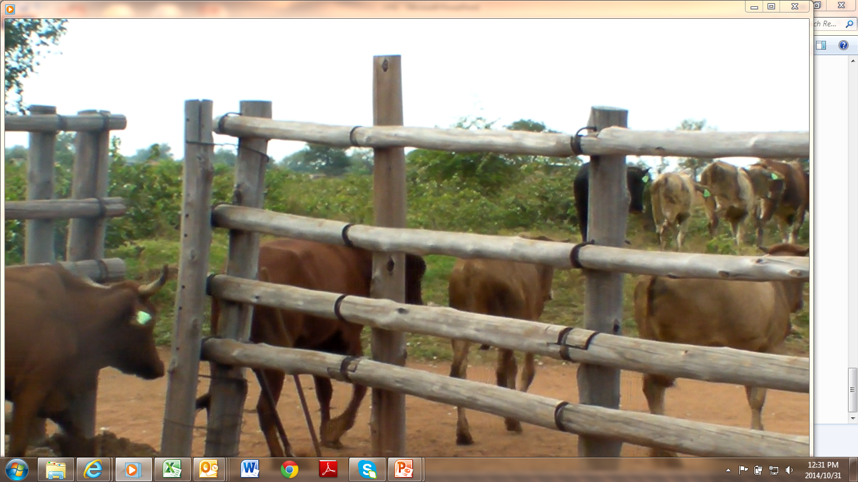
DISEASE CONTROL

Slide 37
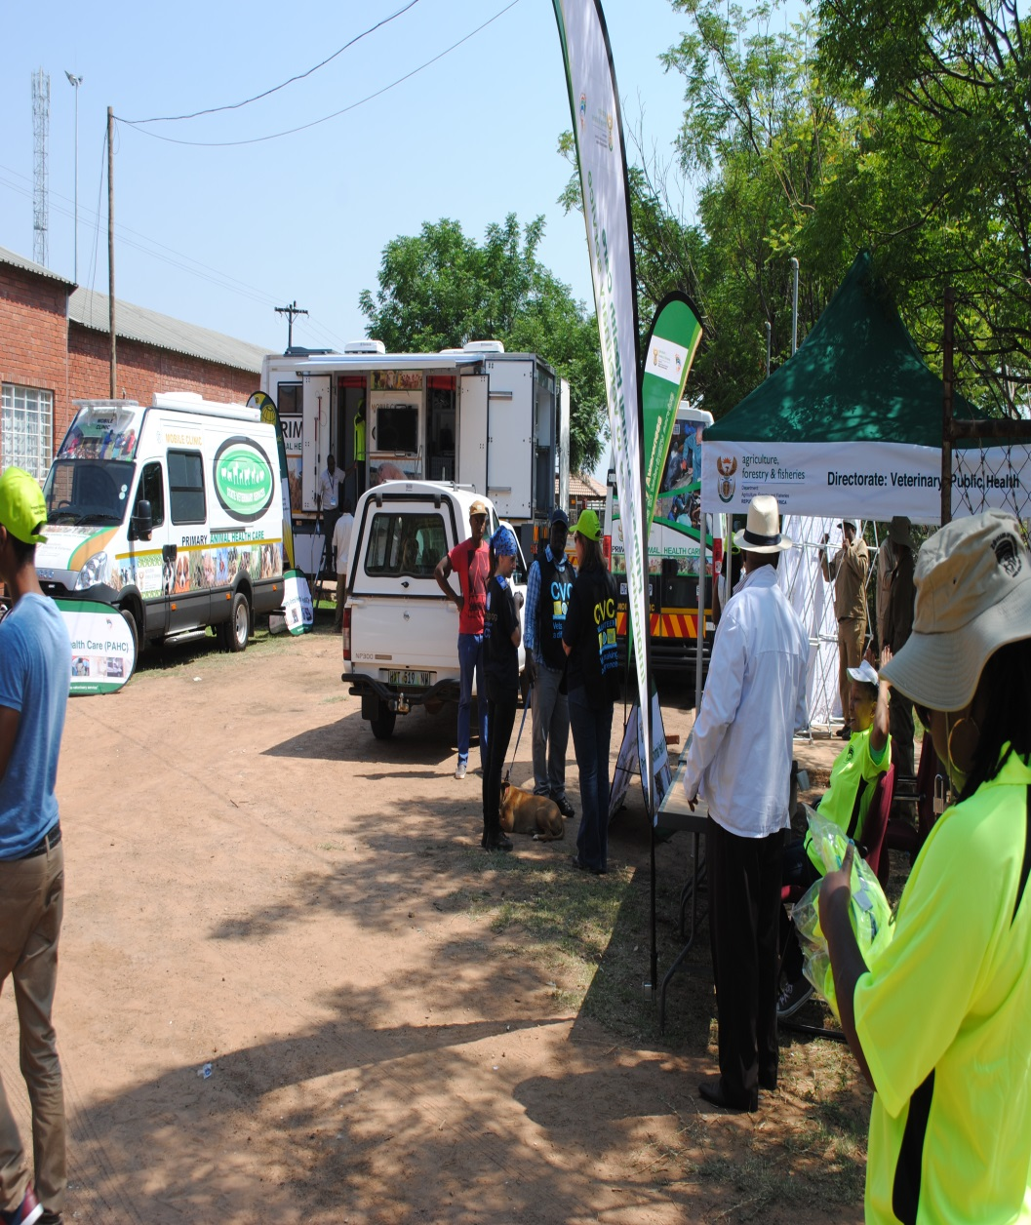
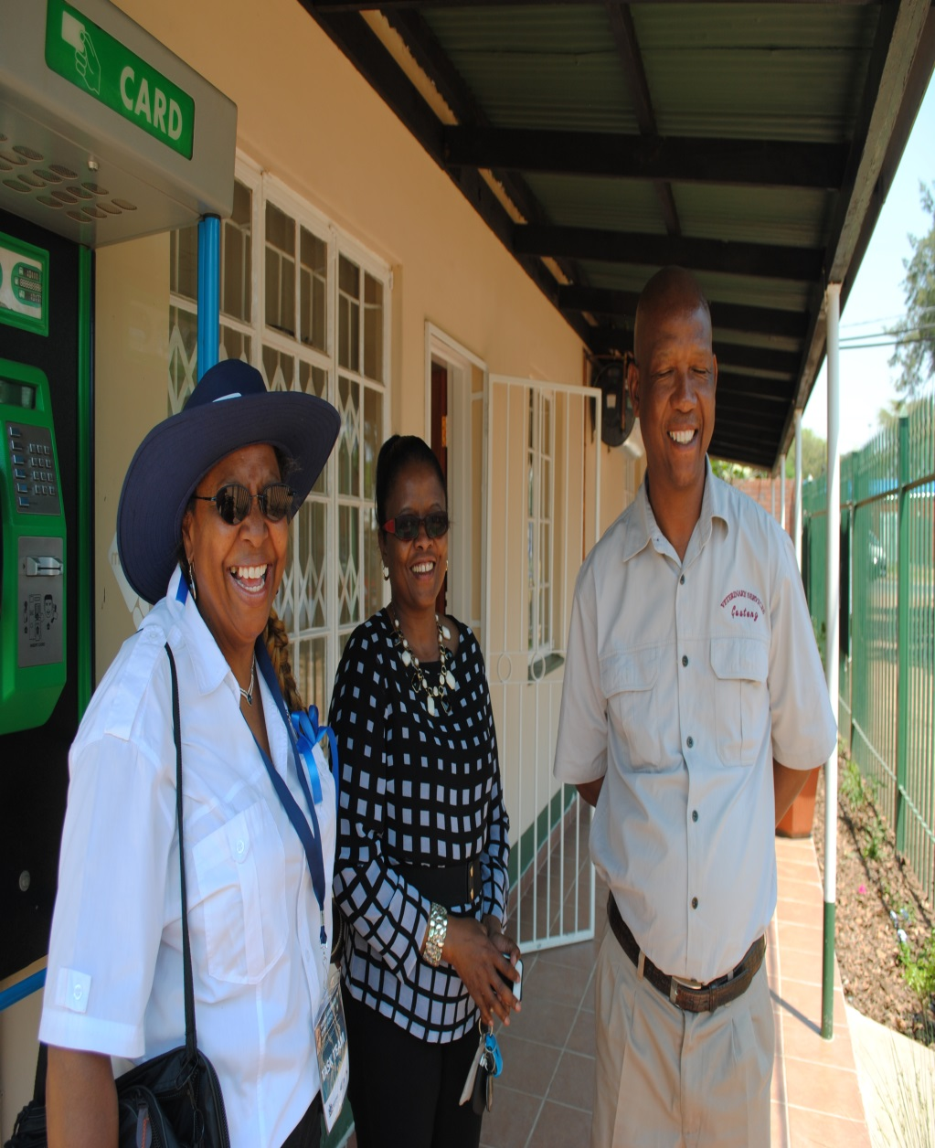
Clinical Services launch

Slide 38
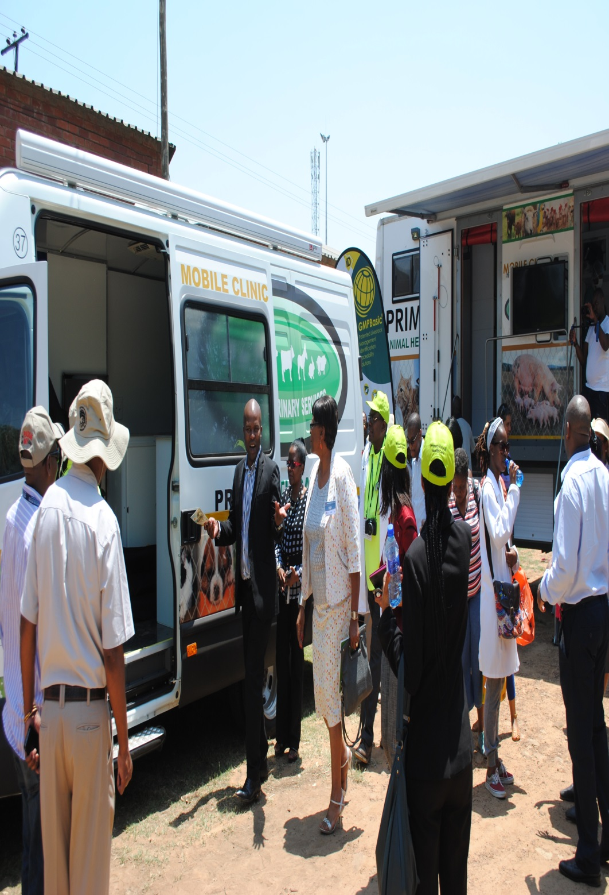

Mobile Clinical Services

Slide 39



Slide 40



CHALLENGES

Slide 41


MOBILE KRAAL

Slide 42

CPSI HANDOVER

Slide 43


Slide 44

Thank you
Acknowledgements
Mpumalanga Vet Services – contributions in our strategy
DAFF
Gauteng Provincial Government
CPSI
Mpumalanga Premier's Office

