Slide 1
SERO PRESENTATION – RESPONDING TO THE SOCIO-ECONOMIC CHALLENGES OF MPUMALANGA
Mpumalanga SMS Summit
Ingwenyama, White River
26-28 November 2014

Slide 2
PURPOSE OF PRESENTATION
To inform the House about the socio-economic situation and challenges of Mpumalanga for planning, decision making, intervention & budget purposes – importance of evidence-based decision making!
Presentation mainly based on Department of Finance’s SERO (Socio-Economic Review & Outlook of Mpumalanga) and PERO (Provincial Economic Review & Outlook) reports as well as Socio-Economic Profiles of Municipalities
Primary source of information Stats SA – also other credible sources where necessary like IHS Global Insight

Slide 3
SOCIO-ECONOMIC RESEARCH
Socio-economic research | Inform planning & budget processes | Planning and Budget | Priorities, strategies & spending | Economic impact
Demographics Labour Education & health Basic service delivery/infrastructure Development & income Poverty & inequality Economic industries/sectors & performance |  |  |  | Service delivery Economic growth & development Unemployment Poverty Inequality
 |  | Socio-economic framework
 |  | MTSF & Outcomes National priorities National budget SONA National Department Policies & NDP PGDS & IDP/LED SOPA & MEGDP Vision 2030

Slide 4
BUDGET AS TOOL FOR GROWTH & DEVELOPMENT
National & Local Governments’ budgets
MPG budget
Private sector & Other institutions’ budgets
Education
Health
Economy & Employment
Poverty & Inequality
Inclusive Rural Development
Integrated Human Settlements
Expenditure
To improve the lives of more than 4 million citizens in Mpumalanga
Impact on development priorities
Expenditure
Expenditure

Slide 5
SOCIO-ECONOMIC CHALLENGES OF MPUMALANGA
Socio-economic challenges
High HIV prevalence
Educational challenges
High unemployment
Low HDI
High inequality
High poverty
Household services challenges
Low economic growth
High inflation
Sectoral dependency
Unequal economic distribution
MEGDP & NDP central challenges
1. Reduce unemployment
2. Reduce poverty
3. Reduce inequality

Slide 6
DEMOGRAPHICS OF MPUMALANGA
Region | Census |  |  |  | 2014 Mid-year estimates
 | 2001 |  | 2011
 | Number | % share of national | Number | % share of national | Number | % share of national
Western Cape | 4 524 335 | 10.1 | 5 822 734 | 11.2 | 6 116 300 | 11.3
Eastern Cape | 6 278 651 | 14.0 | 6 562 053 | 12.7 | 6 786 900 | 12.6
Northern Cape | 991 919 | 2.2 | 1 145 861 | 2.2 | 1 166 700 | 2.2
Free State | 2 706 775 | 6.0 | 2 754 590 | 5.3 | 2 786 800 | 5.2
KwaZulu-Natal | 9 584 129 | 21.4 | 10 267 300 | 19.8 | 10 694 400 | 19.8
North West | 2 984 097 | 6.7 | 3 509 953 | 6.8 | 3 676 300 | 6.8
Gauteng | 9 388 855 | 20.9 | 12 272 263 | 23.7 | 12 914 800 | 23.9
Mpumalanga | 3 365 554 | 7.5 | 4 039 939 | 7.8 | 4 229 300 | 7.8
Limpopo | 4 995 462 | 11.1 | 5 404 868 | 10.4 | 5 630 500 | 10.4
Total | 44 819 777 | 100.0 | 51 770 560 | 100.0 | 54 002 000 | 100.0

Slide 7
DEMOGRAPHICS OF MPUMALANGA
Females numbered 2.15 million - 50.9% of the population in 2014
Youth cohort (0-34 yrs) made up 69.9% of the population in 2014
0-4 yrs cohort was the most populous – 11.5% of the population in 2014
Life expectancy for the period 2011-2016 is projected at 56.9 yrs for males & 60.1 yrs for females
Mpumalanga’s percentage of persons aged 5 yrs and older with disability was 5.3% in 2013

Slide 8
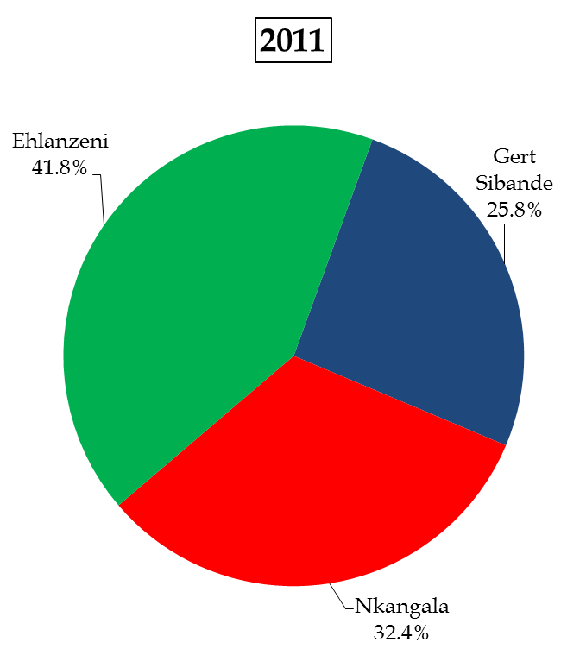
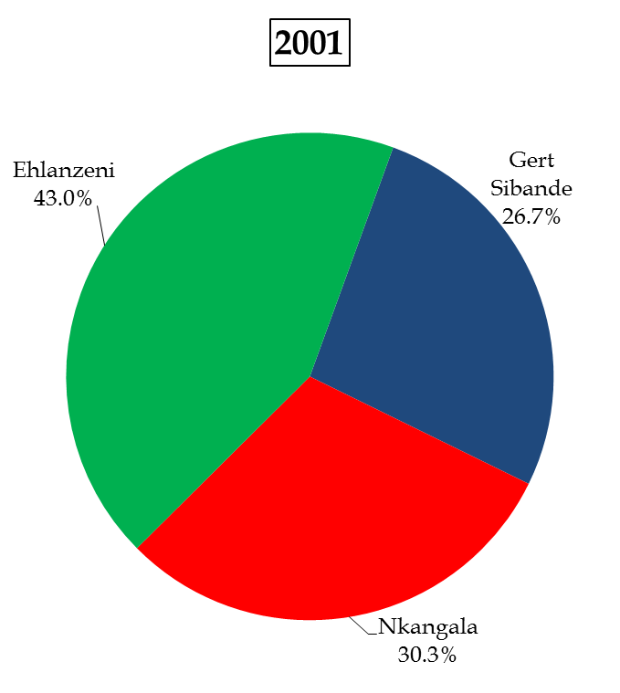
DEMOGRAPHICS
Notes:
Population
2001 = 3.37 million vs 2011 = 4.04 million – 7.8% of SA – 6th largest population
SA increase 15.5% vs MP 20.0% (1.8% per annum) – 3rd highest
Females
2001 = 52.4% vs 2011 = 51.1%
Males
2001 = 47.6% vs 2011 = 48.9%
Median age
MP = 23 vs SA 25
Elderly
2001 = 4.3% (144 000) vs 2011 = 4.7% (190 000)
Increased by 31.9% (2.8% per annum)
Working age
2001 = 59.9% vs 2011 = 64.1%
0-30
2001 = 65.7% vs 2011 = 62.0% Demographic dividend or demographic bomb
0-14
2001 = 35.8% (1.2 million) vs 2011 = 31.2% (1.26 million)
0-4
2001 = 11.3% (380 000) vs 11.4% (462 000)
Increased by 21.6% (2.0% per annum)
Migration
52 000 net in-migration – one of 4 provinces with + net

Slide 9
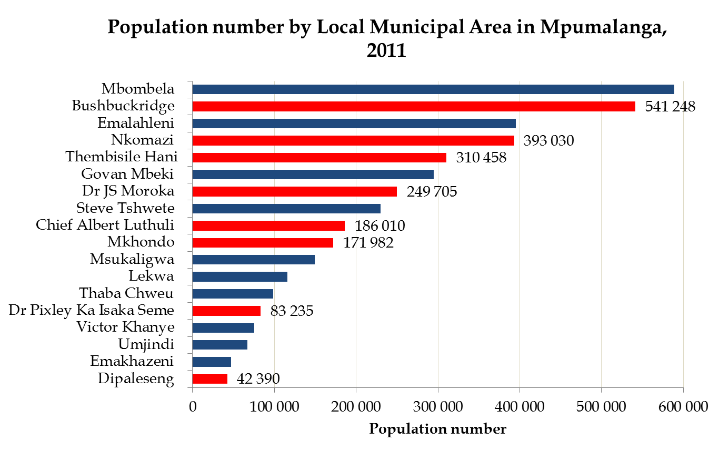
DEMOGRAPHICS OF MPUMALANGA
= CRDP Sites
Notes:
Population
2001 = 3.37 million vs 2011 = 4.04 million – 7.8% of SA – 6th largest population
SA increase 15.5% vs MP 20.0% (1.8% per annum) – 3rd highest
Females
2001 = 52.4% vs 2011 = 51.1%
Males
2001 = 47.6% vs 2011 = 48.9%
Median age
MP = 23 vs SA 25
Elderly
2001 = 4.3% (144 000) vs 2011 = 4.7% (190 000)
Increased by 31.9% (2.8% per annum)
Working age
2001 = 59.9% vs 2011 = 64.1%
0-30
2001 = 65.7% vs 2011 = 62.0% Demographic dividend or demographic bomb
0-14
2001 = 35.8% (1.2 million) vs 2011 = 31.2% (1.26 million)
0-4
2001 = 11.3% (380 000) vs 11.4% (462 000)
Increased by 21.6% (2.0% per annum)
Migration
52 000 net in-migration – one of 4 provinces with + net

Slide 10
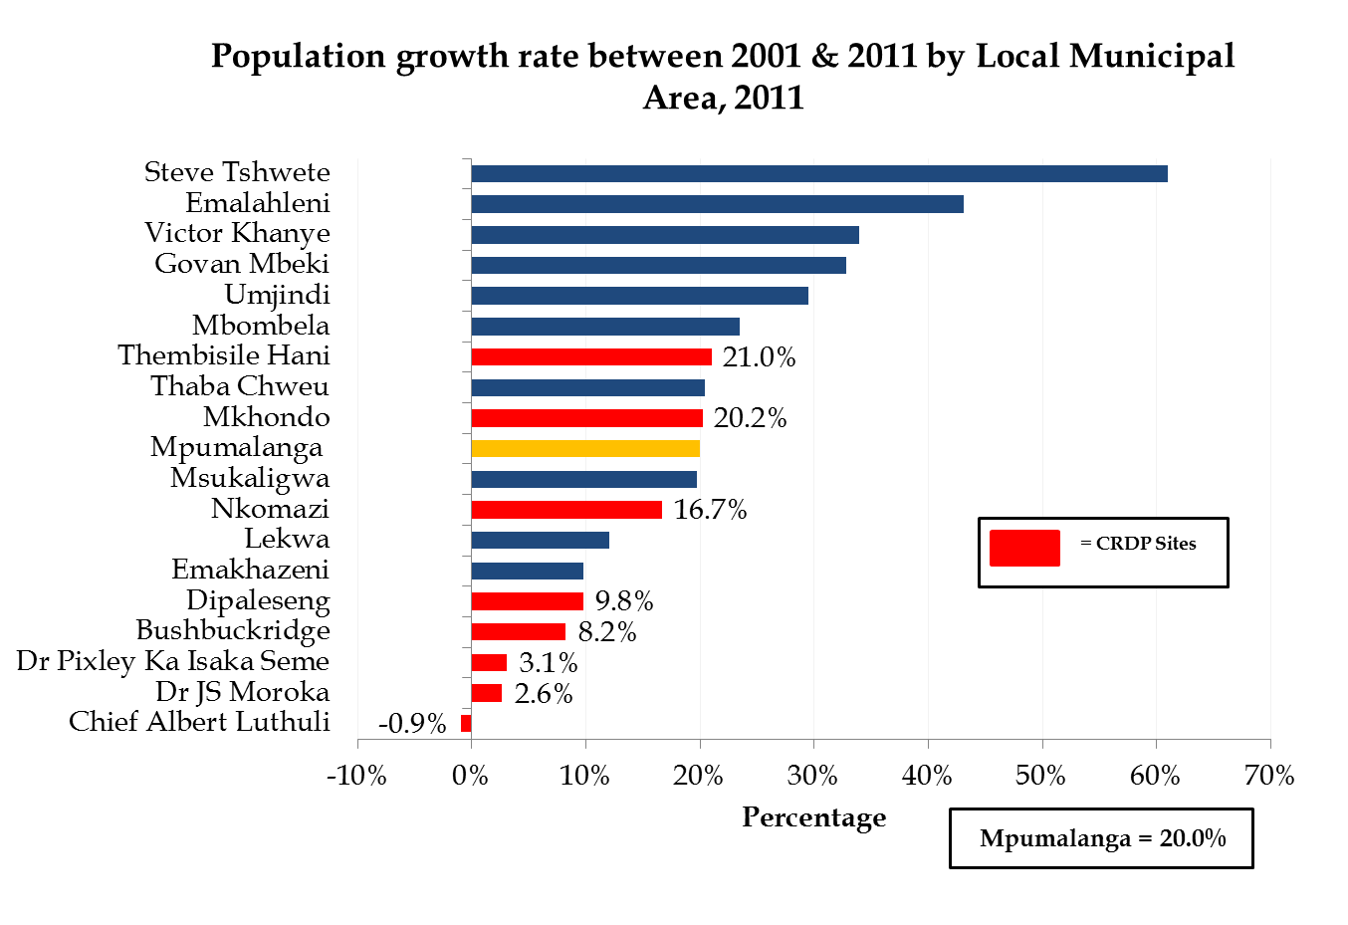
DEMOGRAPHICS OF MPUMALANGA

Slide 11
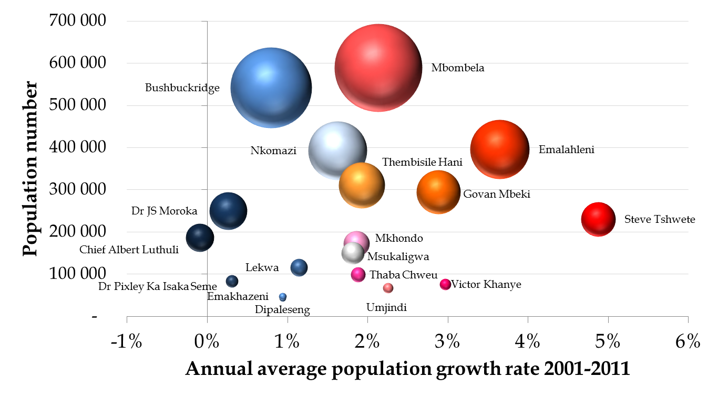
DEMOGRAPHICS
Mpumalanga annual average population growth 2001-11 = 1.8%
By 2030, the share of large 4 unchanged at 47.5%, whilst share of fast 4 will increase from 24.6% to 33.4%
Bubble size = share of Mpumalanga population in 2011

Slide 12
DEMOGRAPHICS
Estimated population number by local municipal area, 2030
Region | Population number 2011 | Average annual growth rate 2001-2011 | Estimated population number 2030
Dipaleseng | 42 390 | 0.9% | 50 601
Emakhazeni | 47 216 | 0.9% | 56 381
Dr Pixley Ka Isaka Seme | 83 235 | 0.3% | 88 196
Umjindi | 67 156 | 2.3% | 102 546
Victor Khanye | 75 452 | 3.0% | 131 452
Thaba Chweu | 98 387 | 1.9% | 140 117
Lekwa | 115 662 | 1.1% | 143 464
Chief Alberl Luthuli | 186 010 | -0.1% | 182 746
Msukaligwa | 149 377 | 1.8% | 210 153
Mkhondo | 171 982 | 1.9% | 243 960
Dr JS Moroka | 249 705 | 0.3% | 262 316
Thembisile Hani | 310 458 | 1.9% | 445 939
Govan Mbeki | 294 538 | 2.9% | 505 103
Nkomazi | 393 030 | 1.6% | 533 418
Steve Tshwete | 229 831 | 4.9% | 567 889
Bushbuckridge | 541 248 | 0.8% | 628 920
Emalahleni | 395 466 | 3.6% | 781 008
Mbombela | 588 794 | 2.1% | 878 773

Slide 13
YOUTH INDICATORS
Relevant indicators regarding youth by region, 2011 Census
Region | Young people (0-34 years) as % of population | Child headed households as % of total households | Child support grant as % of total grants (2013/14) | Youth unemployment rate
Gert Sibande | 69.0% | 0.7% | 72.3% | 38.4%
Chief Albert Luthuli | 72.5% | 1.1% | 77.0% | 45.1%
Msukaligwa | 69.1% | 0.6% | 71.5% | 34.5%
Mkhondo | 72.9% | 1.1% | 73.0% | 44.6%
Dr Pixley Ka Isaka Seme | 69.3% | 1.2% | 69.3% | 45.1%
Lekwa | 65.2% | 0.3% | 64.5% | 35.2%
Dipaleseng | 65.5% | 0.4% | 62.3% | 45.2%
Govan Mbeki | 66.4% | 0.4% | 65.3% | 34.4%
Nkangala | 67.1% | 0.6% | 72.8% | 39.6%
Victor Khanye | 65.5% | 0.4% | 74.1% | 35.8%
Emalahleni | 65.6% | 0.3% | 74.8% | 36.0%
Steve Tshwete | 63.7% | 0.3% | 71.5% | 27.1%
Emakhazeni | 65.6% | 0.5% | 66.4% | 34.2%
Thembisile Hani | 68.7% | 0.9% | 76.6% | 49.4%
Dr JS Moroka | 66.9% | 1.0% | 70.2% | 61.4%
Ehlanzeni | 72.1% | 1.2% | 77.0% | 44.2%
Thaba Chweu | 63.7% | 0.5% | 66.4% | 27.1%
Mbombela | 69.9% | 0.6% | 77.3% | 37.6%
Umjindi | 67.3% | 0.6% | 70.6% | 36.2%
Nkomazi | 75.5% | 1.5% | 80.5% | 42.3%
Bushbuckridge | 74.0% | 2.0% | 76.5% | 64.6%
Mpumalanga | 69.4% | 0.9% | 74.5% | 41.1%

Slide 14
ECONOMIC PERFORMANCE
ECONOMIC GROWTH RESULTS & FORECAST
Economic growth target set at minimum average annual GDP growth of 5% (structural challenges – energy constraints, skills etc)
Provincial economic growth rate of just less than 3% pa since 1995 – primary sector’s growth a modest 1.3% per annum
Lower than national growth with the exception of 1995-1999
Before the recession the end of 2008, the provincial growth rate was more than 4% per annum between 2005 & 2007
Between 2009 & 2013, Mpumalanga’s GDP growth was only 2.2% per annum – 1.7% growth rate last year
Growth prospects for 2014 not good – national growth -1.6% in Q1 2014, 0.5% in Q2 & 1.4% in Q3 2014 – NT & SARB forecast 1.4% for full year – mining & manufacturing low/negative growth in the first 3 quarters of 2014 - 1.3% growth expected for Mpumalanga this year
Forecasted average annual GDP growth for Mpumalanga between 2013 & 2018 below 3.0% per annum – global economic environment fragile & uneven

Slide 15
ECONOMIC PERFORMANCE
INDUSTRY GROWTH & CONTRIBUTION
No provincial industry/sector with an average annual economic growth in excess of the targeted 5% between 2009 & 2013
Mining, trade and community services achieved the highest economic growth rates between 2009 & 2013 (2.3% per annum) & agriculture the lowest (-0.7% per annum) – agriculture performing much better in 2014
According to the latest re-based and revised GDP figures of StatsSA, mining is the largest industry of Mpumalanga with a contribution of 25% to the provincial economic cake – other large industries with contributions of more than 12% include finance, manufacturing, trade & community services (2010 constant prices)
Contribution of Mpumalanga to the SA economy in 2013, 7.6% (size of provincial economy R270 billion) & substantial contributions to the national economy in the following industries/sectors – mining (23.7%), agriculture (8.4%) and utilities (8.1%) – all in current prices

Slide 16
ECONOMIC PERFORMANCE
Real GDP growth for Euro Area, Europe, South Africa & Mpumalanga, 2003-2013
Year | Euro (€) Area | Western Europe | Eastern Europe | Total Europe | South Africa | Mpumalanga
2003 | 0.7% | 1.2% | 6.3% | 2.4% | 2.9% | 2.8%
2004 | 2.2% | 2.4% | 7.1% | 3.5% | 4.6% | 4.0%
2005 | 1.7% | 2.0% | 5.6% | 2.9% | 5.3% | 4.4%
2006 | 3.3% | 3.2% | 7.5% | 4.3% | 5.6% | 4.2%
2007 | 3.0% | 3.1% | 7.6% | 4.3% | 5.4% | 4.1%
2008 | 0.4% | 0.2% | 4.8% | 1.5% | 3.2% | 1.3%
2009 | -4.5% | -4.3% | -6.4% | -4.9% | -1.5% | -1.3%
2010 | 1.9% | 2.0% | 3.6% | 2.4% | 3.0% | 2.7%
2011 | 1.6% | 1.6% | 3.9% | 2.2% | 3.2% | 2.2%
2012 | -0.7% | -0.3% | 2.1% | 0.4% | 2.2% | 2.2%
2013 | -0.4% | 0.1% | 1.3% | 0.4% | 1.9% | 1.7%

Slide 17
INDUSTRY CONTRIBUTION & GROWTH
Provincial industry contribution and growth (constant 2010 prices), 2009-2013
Industry | GVA percentage share 2013 | Industry average annual growth, 2009-2013 | Future growth 2013-2018
Agriculture | 3.0% | -0.7% | Low
Mining | 25.4% | 2.3% | Low
Manufacturing | 13.3% | 2.1% | Medium
Utilities | 5.4% | 0.6% | High
Construction | 3.3% | 1.3% | Medium
Trade | 15.0% | 2.3% | Medium
Transport | 6.0% | 1.8% | High
Finance | 12.2% | 2.2% | High
Community services | 16.3% | 2.3% | Medium
Total/GVA | 100% | 2.1% | Medium
Low = less than 2% Medium = between 2% & 3.9% High = 4.0 % and higher

Slide 18
ECONOMIC CONTRIBUTION
Contribution to Mpumalanga’s industries’ GVA (constant 2005 prices), 1996-2013
Industry | Gert Sibande |  | Nkangala |  | Ehlanzeni
 | 1996 | 2013 | 1996 | 2013 | 1996 | 2013
Agriculture | 41.9% | 41.6% | 24.0% | 22.8% | 34.1% | 35.6%
Mining | 37.1% | 23.6% | 50.0% | 67.6% | 12.8% | 8.8%
Manufacturing | 43.3% | 53.5% | 31.8% | 27.6% | 24.8% | 19.0%
Utilities | 26.3% | 25.1% | 69.9% | 71.8% | 3.8% | 3.1%
Construction | 24.9% | 24.6% | 30.5% | 34.4% | 44.6% | 41.1%
Trade | 26.6% | 24.3% | 27.5% | 31.7% | 45.9% | 44.0%
Transport | 27.4% | 23.0% | 33.7% | 39.5% | 38.8% | 37.6%
Finance | 21.6% | 20.6% | 36.3% | 36.9% | 42.1% | 42.4%
Community services | 22.7% | 22.8% | 32.5% | 32.8% | 44.8% | 44.5%
Total | 31.6% | 29.6% | 38.3% | 40.9% | 30.2% | 29.6%

Slide 19
ECONOMIC CONTRIBUTION
Contribution to individual districts’ GVA (constant 2005 prices) by industry, 1996-2013
Industry | Gert Sibande |  | Nkangala |  | Ehlanzeni
 | 1996 | 2013 | 1996 | 2013 | 1996 | 2013
Agriculture | 5.5% | 4.7% | 2.6% | 1.9% | 4.7% | 4.0%
Mining | 27.9% | 15.0% | 31.0% | 31.1% | 10.1% | 5.6%
Primary industries | 33.4% | 19.7% | 33.6% | 32.9% | 14.8% | 9.6%
Manufacturing | 25.0% | 35.0% | 15.2% | 13.1% | 15.0% | 12.4%
Utilities | 4.9% | 3.9% | 10.7% | 8.1% | 0.7% | 0.5%
Construction | 1.6% | 2.1% | 1.6% | 2.1% | 3.0% | 3.5%
Secondary industries | 31.5% | 41.0% | 27.5% | 23.2% | 18.7% | 16.4%
Trade | 9.1% | 9.5% | 7.8% | 8.9% | 16.4% | 17.1%
Transport | 5.7% | 7.2% | 5.8% | 9.0% | 8.4% | 11.8%
Finance | 7.6% | 9.7% | 10.5% | 12.5% | 15.4% | 19.9%
Community services | 12.7% | 12.8% | 15.0% | 13.4% | 26.2% | 25.1%
Tertiary industries | 35.1% | 39.3% | 39.0% | 43.8% | 66.5% | 74.0%
Total | 100.0% | 100.0% | 100.0% | 100.0% | 100.0% | 100.0%

Slide 20
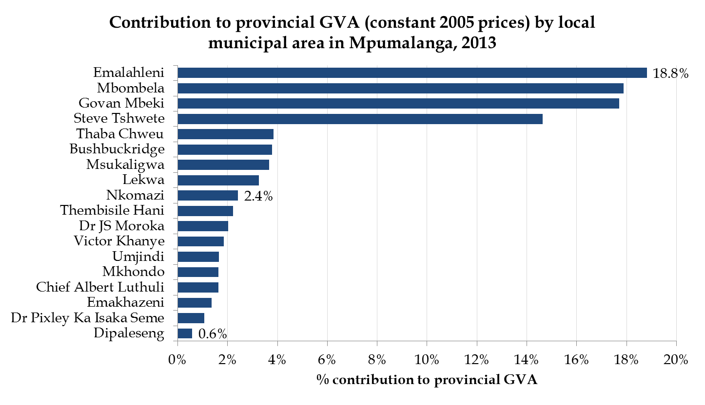
ECONOMIC CONTRIBUTION

Slide 21
ECONOMIC GROWTH
Historic GDP (constant 2005 prices) growth rate per region, 1996-2013
Region | Historic
 | 1996-2013
Gert Sibande | 2.3%
Chief Albert Luthuli | 2.4%
Msukaligwa | 2.2%
Mkhondo | 1.2%
Dr Pixley Ka Isaka Seme | 2.7%
Lekwa | 0.7%
Dipaleseng | 0.3%
Govan Mbeki | 2.7%
Nkangala | 2.9%
Victor Khanye | 2.4%
Emalahleni | 3.0%
Steve Tshwete | 3.0%
Emakhazeni | 4.7%
Thembisile Hani | 2.4%
Dr JS Moroka | 2.0%
Ehlanzeni | 2.4%
Thaba Chweu | 3.9%
Mbombela | 2.5%
Umjindi | 0.8%
Nkomazi | 1.3%
Bushbuckridge | 1.8%

Slide 22
TOURISM INDICATORS
Value & contribution of total tourism spend per region, 2013
Region | Total tourism spend (R-million) | Tourism spend as % of GDP (current prices)
Gert Sibande | R 3 696 | 5.4%
Chief Albert Luthuli | R 371 | 9.2%
Msukaligwa | R 359 | 4.1%
Mkhondo | R 263 | 6.6%
Dr Pixley Ka Isaka Seme | R 139 | 5.2%
Lekwa | R 173 | 2.0%
Dipaleseng | R 62 | 4.1%
Govan Mbeki | R 2 330 | 5.9%
Nkangala | R 4 765 | 4.4%
Victor Khanye | R 426 | 9.6%
Emalahleni | R 1 645 | 3.2%
Steve Tshwete | R 1 246 | 3.3%
Emakhazeni | R 769 | 24.4%
Thembisile Hani | R 355 | 6.4%
Dr JS Moroka | R 324 | 6.3%
Ehlanzeni | R 9 356 | 13.8%
Thaba Chweu | R 1 449 | 18.8%
Mbombela | R 4 924 | 12.2%
Umjindi | R 251 | 6.2%
Nkomazi | R 1 777 | 29.1%
Bushbuckridge | R 955 | 9.9%
Mpumalanga | R 17 818 | 7.3%

Slide 23
JOB CREATION & UNEMPLOYMENT
OBJECTIVE: TO CREATE EMPLOYMENT & REDUCE UNEMPLOYMENT
Total employment number must rise from more than 1.1 million to approximately 1.5 million in 2019 & to 2.4 million by 2030
On average more than 81 000 new & sustainable jobs must be created annually up to 2030 – employment growth of 4.9% per annum
The unemployment rate must decrease to 15% by 2020 (MEGDP) & 6% by 2030 (NDP & Vision 2030)

Slide 24
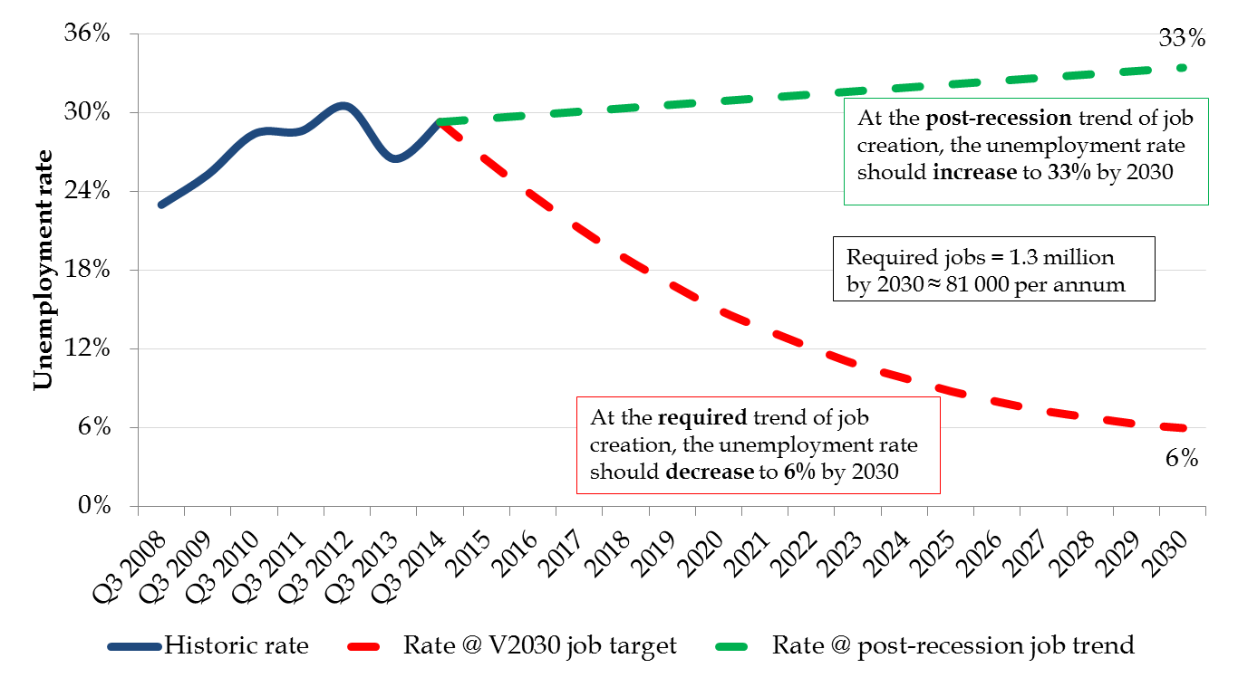
JOB CREATION & UNEMPLOYMENT

Slide 25
JOB CREATION
TOTAL EMPLOYMENT CREATION & BY INDUSTRY
Net job creation 102 151 between Q3 2008 (pre-recession) & Q3 2014 – average of 17 000 jobs pa – achieving just more than 20% of our job creation target!
Net job gains of 7 976 jobs in the third quarter of 2014 & losses of -13 671 on an annual basis
Employment growth of -1.2% on an annual basis (national average 0.5 %)
Construction (19 792), manufacturing (11 957), transport (8 542) as well as finance (8 483) created the highest number of net jobs between Q3 2013 & Q3 2014
Private households (-20 358), trade (-19 140), agriculture (-16 124) and utilities (-9 993) experienced job losses on an annual basis
Importance of interventions in agriculture – challenges with economic growth and job creation - 71 015 people involved in subsistence farming

Slide 26
EMPLOYMENT PER INDUSTRY
Industry | 2008 Q3 | 2014 Q3 | Change in number | Change in %
Agriculture | 92 559 | 82 963 | -9 596 | -10.4%
Mining | 60 793 | 90 422 | 29 629 | 48.7%
Manufacturing | 94 334 | 103 378 | 9 044 | 9.6%
Utilities | 20 055 | 16 779 | -3 276 | -16.3%
Construction | 90 561 | 111 862 | 21 301 | 23.5%
Trade | 273 700 | 234 084 | -39 616 | -14.5%
Transport | 49 716 | 57 987 | 8 271 | 16.6%
Finance | 93 644 | 124 856 | 31 212 | 33.3%
Community services | 160 450 | 230 935 | 70 485 | 43.9%
Private households | 97 412 | 82 108 | -15 304 | -15.7%
Total | 1 033 223 | 1 135 374 | 102 151 | 9.9%

Slide 27
UNEMPLOYMENT
The unemployment rate increased from 24.3% at the end of Q1 2009 to 29.3% at the end of Q3 2014
Mpumalanga’s unemployment rate was 6th highest among the 9 provinces at the end of Q1 2009, 4th highest at the end of Q3 2014
Specific unemployment rates at the end of Q3 2014:
  Male = 25.7%
  Female = 33.6%
  Youth (15-34 yr) = 41.8%
71.3% of the unemployed in Mpumalanga indicated that they have been unemployed in excess of 12 months
The number of unemployed increased from 338 404 in Q1 2009 to 470 552 in Q3 2014 – 132 148 increase!
  The youth (15-34 yr) was 74.4% of the unemployed at the end of Q3 2014!

Slide 28
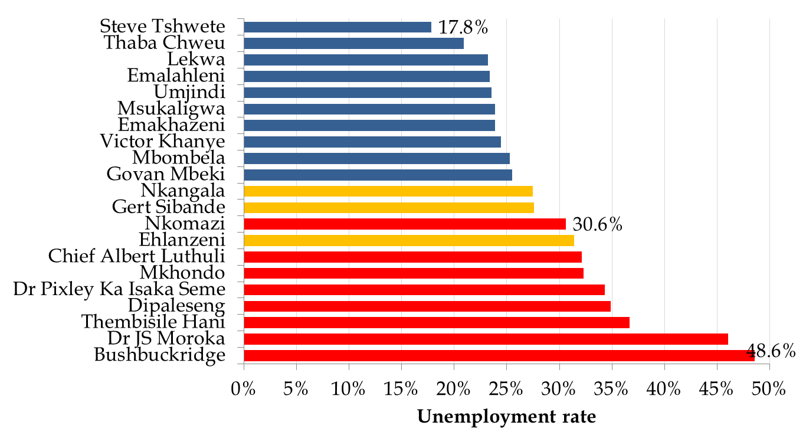
UNEMPLOYMENT - 2013
= CRDP

Slide 29
ECONOMIC DEVELOPMENT & TOURISM
Expenditure/budget:
  Increased from R713 million in 2010/11 to R769 million this year – average increase of only 1.9% pa (below the CPI)
  2.1% of the MPG budget of R37 billion this year
Impact and challenges:
  Mandate – inclusive economic growth (target of 5%+) and creation of decent and sustainable jobs (more than 81 000 new jobs pa to achieve a 15% unemployment rate in 2020) – importance of job tracking in this regard
  Communication, consultation and partnerships with the private sector
  Importance of SMMes and Cooperatives making a difference and impact in terms of job creation – challenges to start a new business and doing business in South Africa! (Global Competitiveness and other relevant reports such as Doing Business in South Africa)
  Importance of the MEGDP and economic interventions in line with it – appointment of service provider to identify interventions per local municipal area and to assist/support with the implementation of LED
  Importance of the development & implementation of provincial investment strategy – important role of MEGA to attract/promote investment and stimulate growth
  MTPA’s expenditure should be in the right areas to promote tourism that will impact positively on job creation and economic growth

Slide 30
DARDLEA
Expenditure/budget:
  Increased from just more than R700 million in 2010/11 to R1.1 billion this year – average increase of 12% pa – more than 45% of budget = COE
  3% of the MPG budget of R37 billion this year
  Infrastructure expenditure increased from only R15 million in 2010/11 to R226 million this year – average increase of 97% pa
Impact and challenges:
  Important coordinating role/responsibility to increase economic growth and create jobs in the 8 CRDP areas
  Relatively good impact of CRDP expenditure the last couple of years – especially in terms of the reduction of poverty & inequality in the CRDP areas – questions however about decent and sustainable jobs as well as the impact on the CRDP economies and more specifically the agricultural industry
  Importance of impact assessment of CRDP projects by DARDLEA – quantitative and qualitative!
  Agriculture the core mandate/business of the Department – addressing challenges in the industry in cooperation with relevant stakeholders, especially in terms of the job losses and low economic growth as well as integrating the more than 70 000 subsistence farmers in the province into the more formal stream of agricultural activities – land issues and challenges!

Slide 31
PWR&T
Expenditure/budget:
  Increased from R2.8 billion in 2010/11 to R4.2 billion this year – average increase of 10.7% pa
  11.4% of the MPG budget of R37 billion this year
  Infrastructure expenditure increased from R1 billion in 2010/11 to R1.8 billion this year – average increase of 15.8% pa – almost 50% of the infrastructure budget!
Impact and challenges:
  Important role to address infrastructure, growth and job creation challenge of Mpumalanga – capacity as implementing agent?
  Impact in terms of road infrastructure and especially EPWP jobs
  Debate regarding the accuracy of the EPWP job opportunity numbers and sustainability of these jobs – not always reflected in official employment numbers?
  Public infrastructure investment target of NDP & Vision 2030, 10% of GDP! MPG infrastructure expenditure less than 2% of the provincial GDP at the moment – need to increase this expenditure with more than 16% pa to achieve the 10% target in 2030!

Slide 32
POVERTY & INEQUALITY
OBJECTIVE TO REDUCE POVERTY & INCOME INEQUALITY
The poverty rate is targeted to be at least 25% by 2020 (MEGDP) & at least 5% by 2030 (Vision 2030)
Reduce the Gini-coefficient in Mpumalanga to at least 0.60 by 2030 (NDP & Vision 2030)
The proportion of income earned by the bottom 40% in Mpumalanga should rise to 10% by 2030 (NDP & Vision 2030)

Slide 33
POVERTY
POVERTY RATE REDUCTION
The share of population in Mpumalanga below the lower-bound poverty line declined/improved from 51.2% in 2009 to 36.5% in 2013
2013 lower-bound poverty line = R513 per capita per month
In 2013, Mpumalanga’s share of population below the lower-bound poverty line was the 4th highest (unfavourable) among the provinces and higher than the SA rate of 34.1%
The number of people below the lower bound poverty line declined from 1.998 million in 2009 to 1.529 million in 2013 – a decline/improvement of 469 162 people

Slide 34
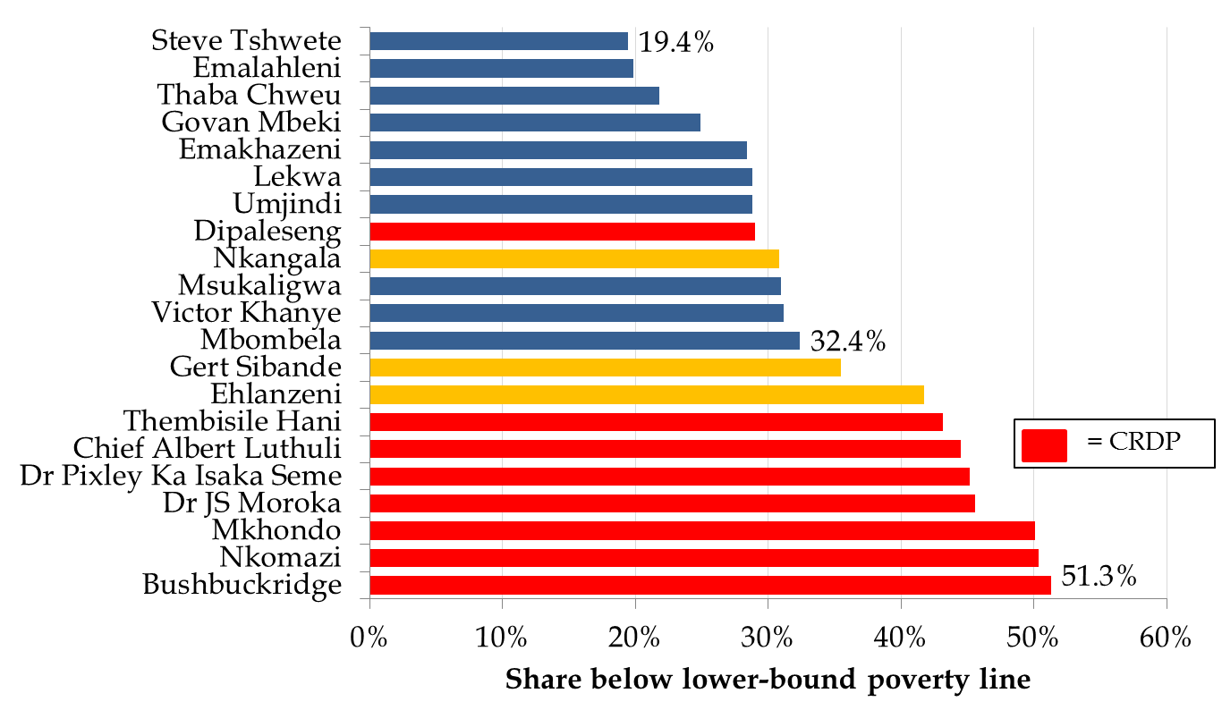
POVERTY (2013)

Slide 35
POVERTY
MULTIDIMENSIONAL POVERTY
Multidimensional poverty constitutes several factors that amount to the poor’s experience of deprivation such as poor health, lack of education, inadequate living standards, lack of income and lack of decent work
The South African Multidimensional Poverty Index (SAMPI) was published by Statistics South Africa in 2014
It is not intended to replace the poverty headcount using the poverty lines that have been developed and should rather be seen as a complementary measure to money-metric measures
Mpumalanga’s SAMPI score was 0.08 in 2001, which was equal to that of South Africa and joint 4th lowest/best
Mpumalanga’s SAMPI score declined/improved to 0.03 in 2011, which was joint 5th lowest and equal to the national score

Slide 36
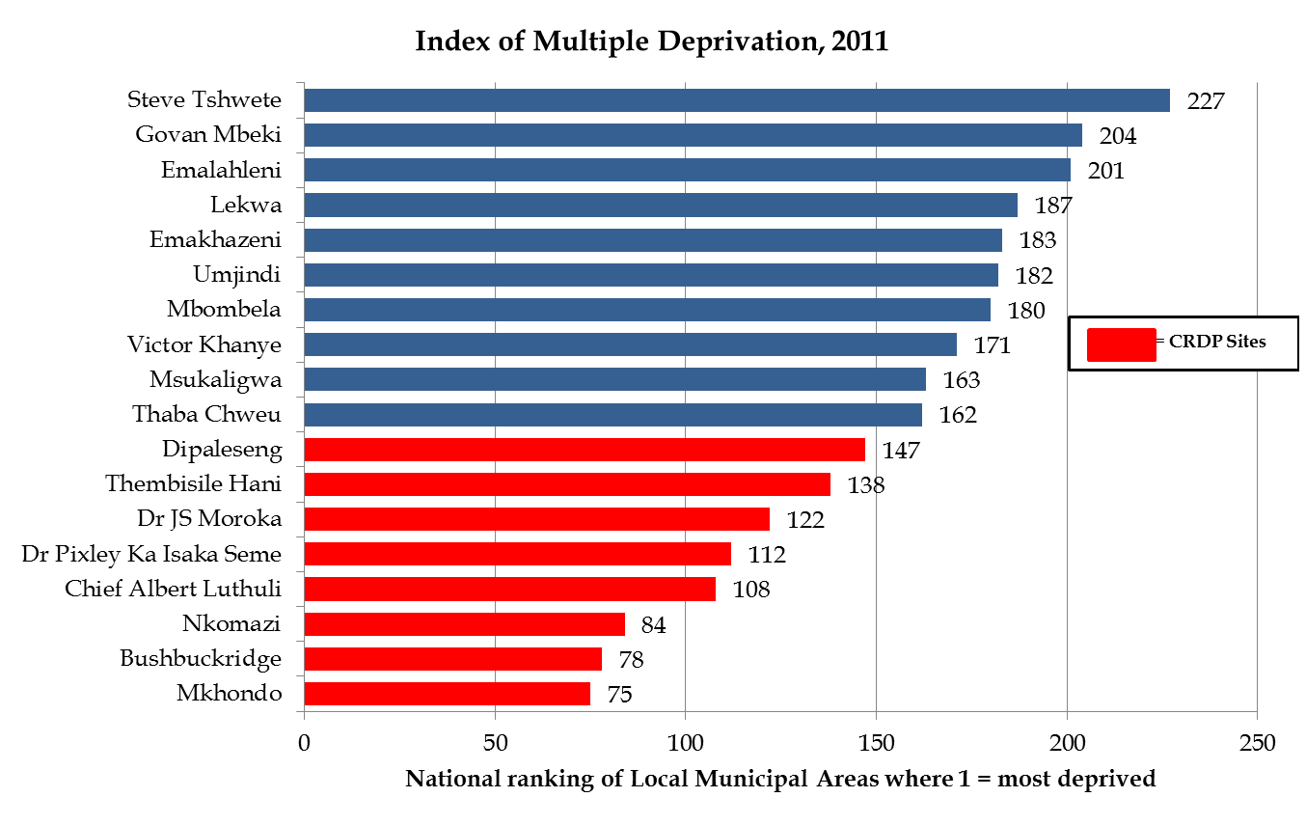
INDEX OF MULTIPLE DEPRIVATION

Slide 37
INEQUALITY
REDUCTION IN INCOME INEQUALITY
The Gini-coefficient in Mpumalanga was unchanged between 2009 and 2013 at 0.62
Income in Mpumalanga was therefore as unequally distributed in 2013 than in 2009
In 2013, Mpumalanga’s Gini-coefficient was joint 4th highest (unfavourable) among the provinces, however, lower/better than SA’s Gini-coefficient of 0.64 in 2013
The proportion of income earned by the bottom 40% in Mpumalanga increased/improved slightly from 7.5% in 2009 to 7.6% in 2013
Mpumalanga’s Palma ratio declined/improved from 6.62 in 2009 to 6.41 in 2013 – the Palma ratio reveals that for every R1 of total income that the poorest 40% earned, the richest 10% earned approximately R6.41

Slide 38
INCOME INEQUALITY
Bottom 40 % ‘s share of the income (2013)
 | 1999 | 2004 | 2009 | 2013 | Ranking: best (1) - worst (18)
Dr JS Moroka | 9.7% | 9.0% | 11.1% | 11.4% | 1
Thembisile Hani | 9.5% | 9.1% | 10.8% | 11.3% | 2
Bushbuckridge | 9.8% | 8.3% | 10.9% | 10.9% | 3
Nkomazi | 9.4% | 8.4% | 9.9% | 10.1% | 4
Chief Albert Luthuli | 9.4% | 7.9% | 9.8% | 10.1% | 5
Mkhondo | 8.4% | 7.6% | 9.0% | 9.3% | 6
Dipaleseng | 9.7% | 7.4% | 8.8% | 8.9% | 7
Emakhazeni | 10.3% | 8.5% | 8.8% | 8.9% | 8
Thaba Chweu | 9.7% | 7.7% | 8.1% | 8.3% | 9
Umjindi | 8.9% | 7.7% | 8.2% | 8.2% | 10
Lekwa | 8.4% | 7.3% | 8.0% | 8.2% | 11
Victor Khanye | 8.0% | 7.2% | 7.8% | 8.2% | 12
Msukaligwa | 8.3% | 6.9% | 7.8% | 8.1% | 13
Dr Pixley Ka Isaka Seme | 7.8% | 6.6% | 7.7% | 8.0% | 14
Mbombela | 7.9% | 6.9% | 7.3% | 7.1% | 15
Steve Tshwete | 7.4% | 6.2% | 6.8% | 7.0% | 16
Emalahleni | 7.6% | 6.1% | 6.8% | 6.8% | 17
Govan Mbeki | 6.3% | 5.6% | 6.0% | 6.2% | 18

Slide 39
POVERTY & INEQUALITY
CRITICAL ANALYSIS
Improvement in the share of population below the lower bound poverty line & distribution of income since 2009
Increase in social grants responsible for some improvement in poverty rate
  Approximately 1 million grants pm (R459 million pm) in 2009/10 to 1.3 million grants pm (R704 million pm) in 2013/14
Despite impact of social grants, job creation is most important factor to impact positively on poverty
Reduce poverty by building & developing capabilities of workforce on a broad scale
Labour market inequality is central to overall inequality & poverty
Skills constraints push up the premium for skilled labour, inducing large differences between salaries of skilled & unskilled people and thus raising levels of inequality
Income inequality can most effectively be reduced by improving the labour force’s skill levels and thus removing the premium for skilled labour – income inequality can’t be reduced without good quality education
Interventions should be aligned to socio-economic status of specific area

Slide 40
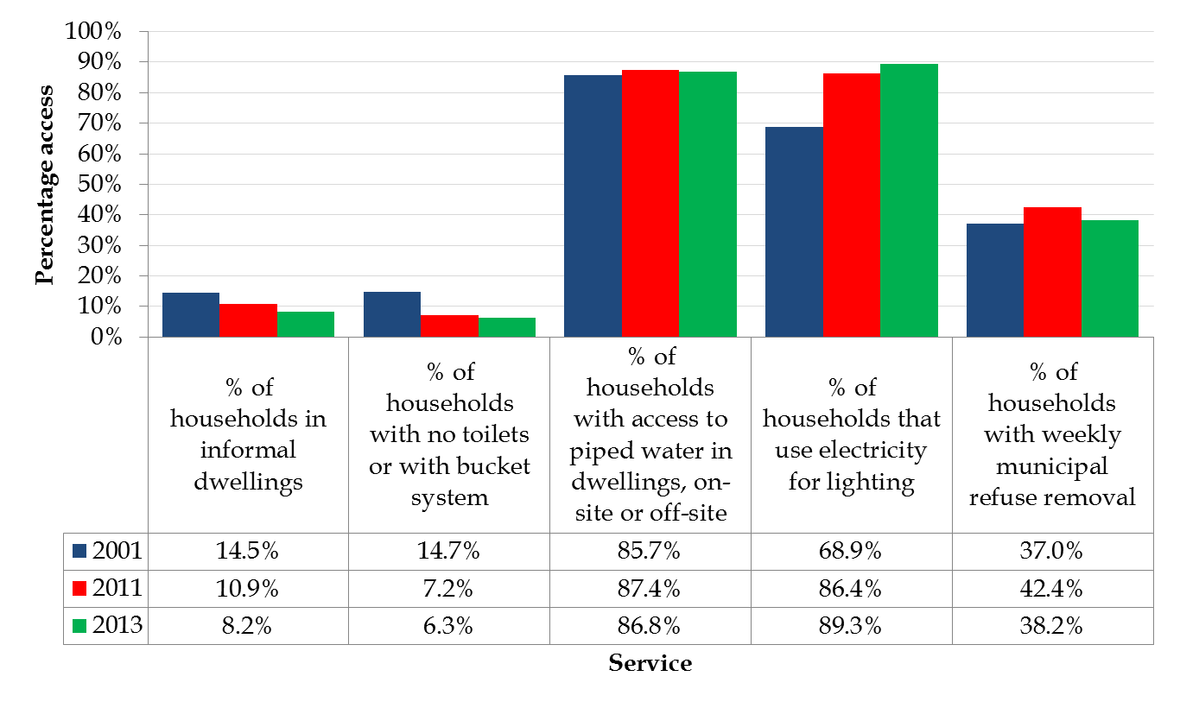
BASIC SERVICE DELIVERY

Slide 41
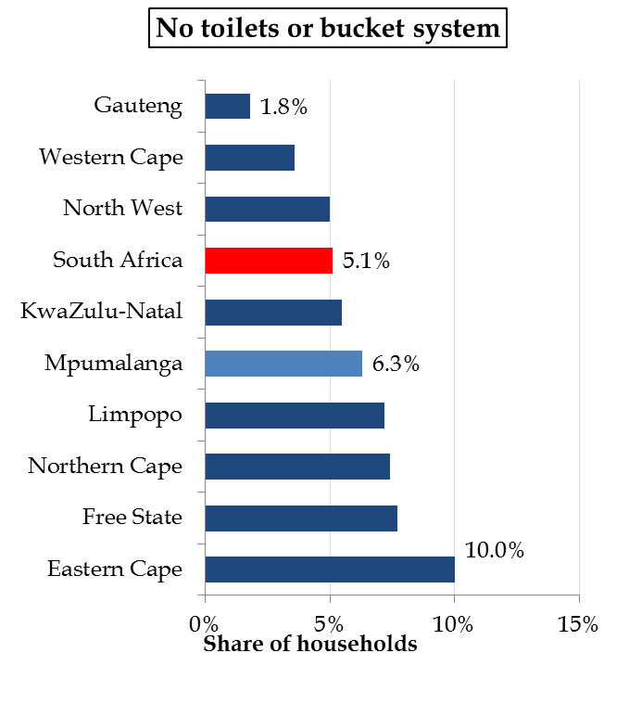
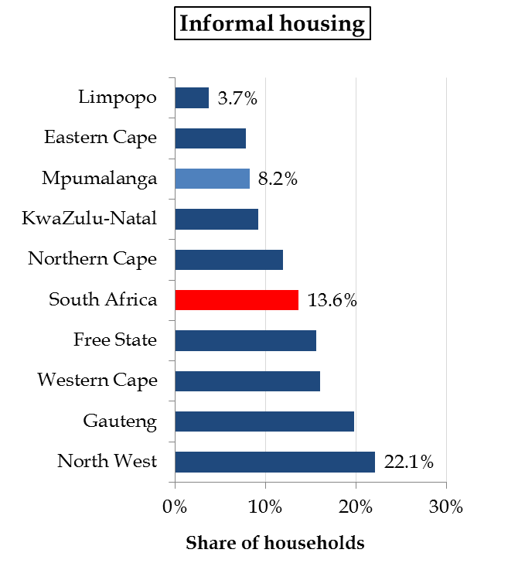
BASIC SERVICE DELIVERY - 2013

Slide 42
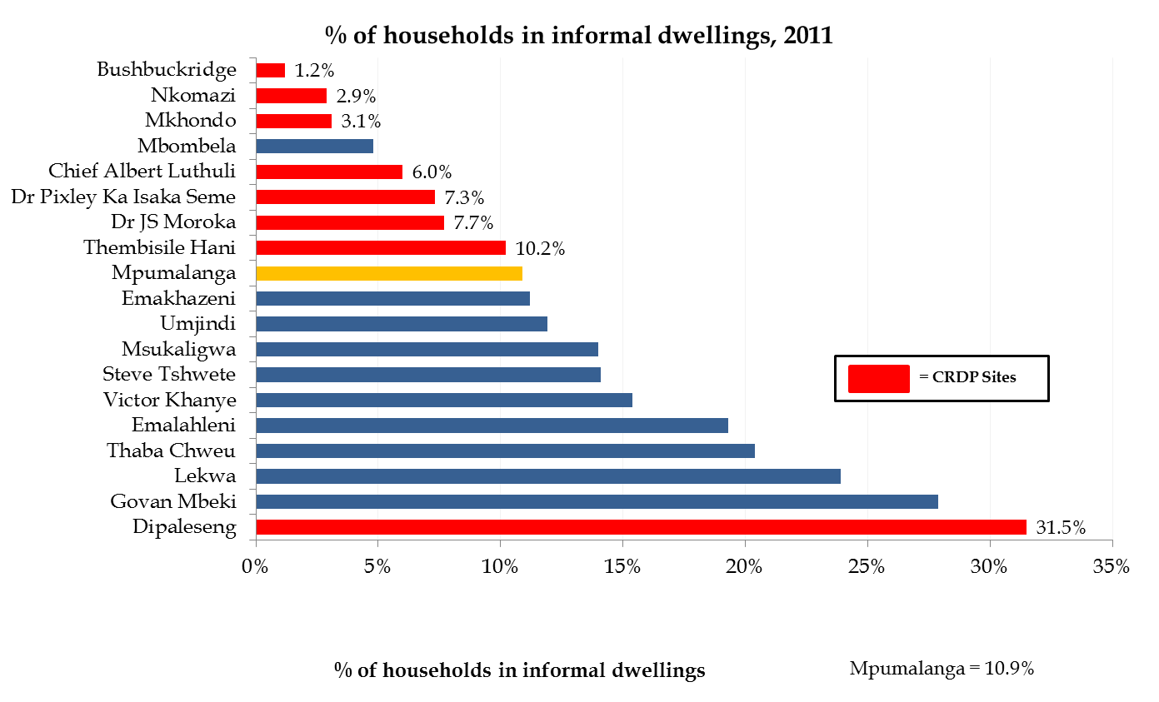
BASIC SERVICE DELIVERY - HOUSING

Slide 43
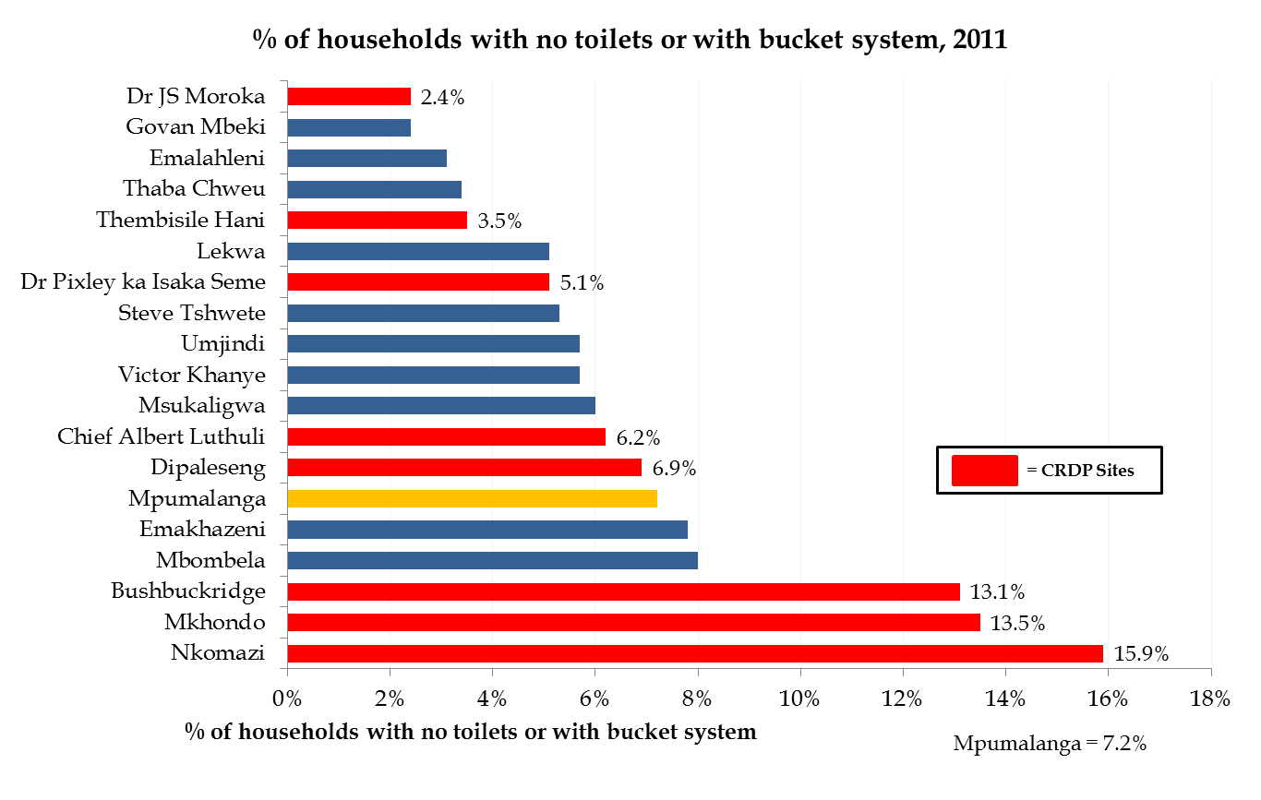
BASIC SERVICE DELIVERY- SANITATION

Slide 44
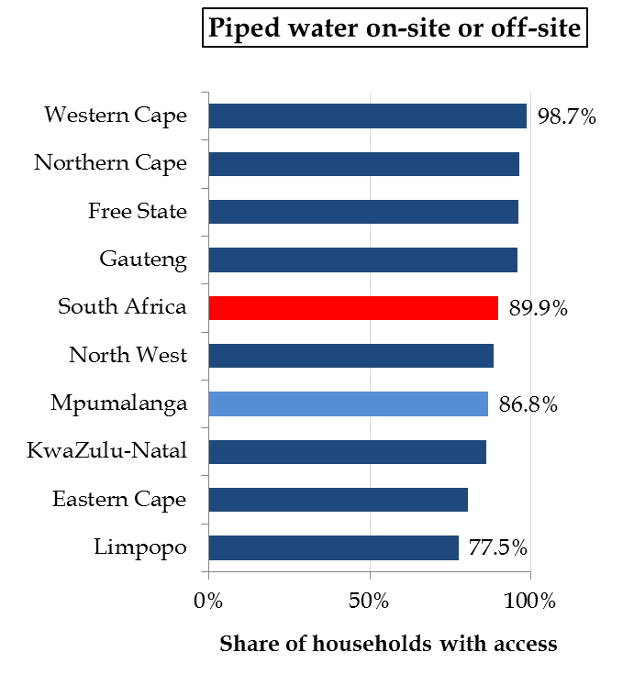
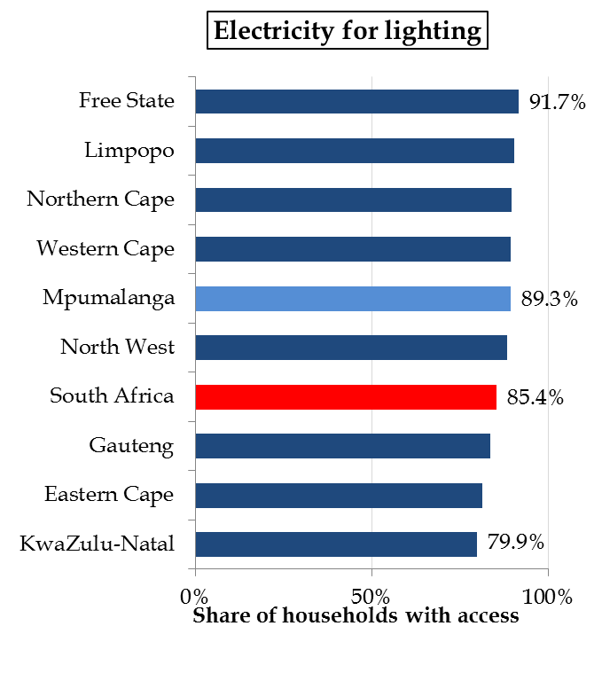
BASIC SERVICE DELIVERY - 2013

Slide 45
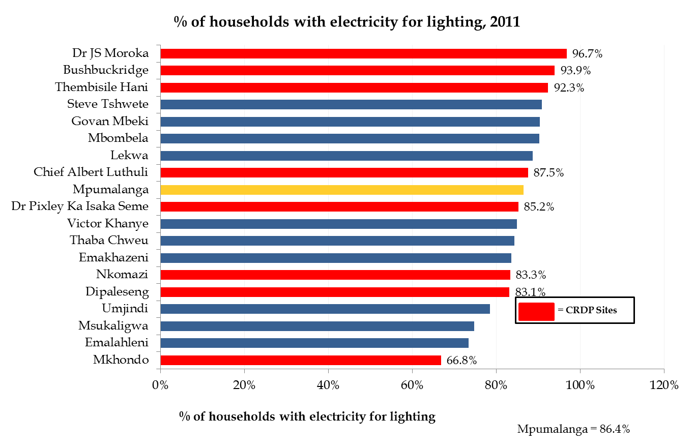
BASIC SERVICE DELIVERY - ELECTRICITY

Slide 46
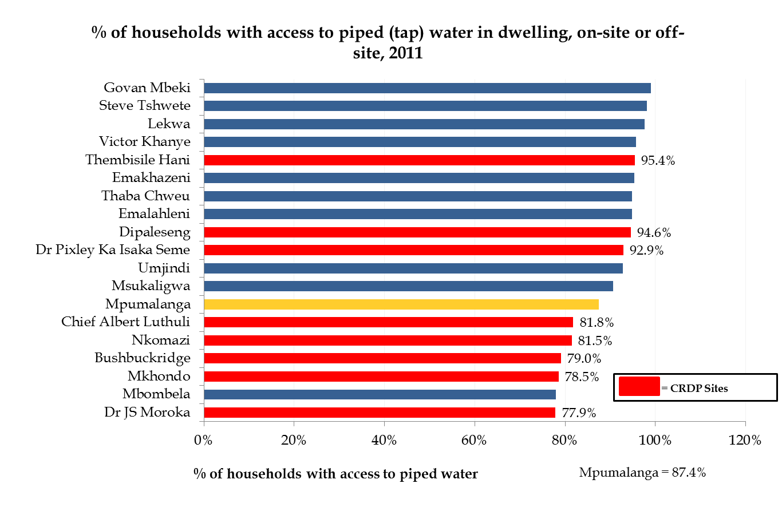
BASIC SERVICE DELIVERY - WATER

Slide 47
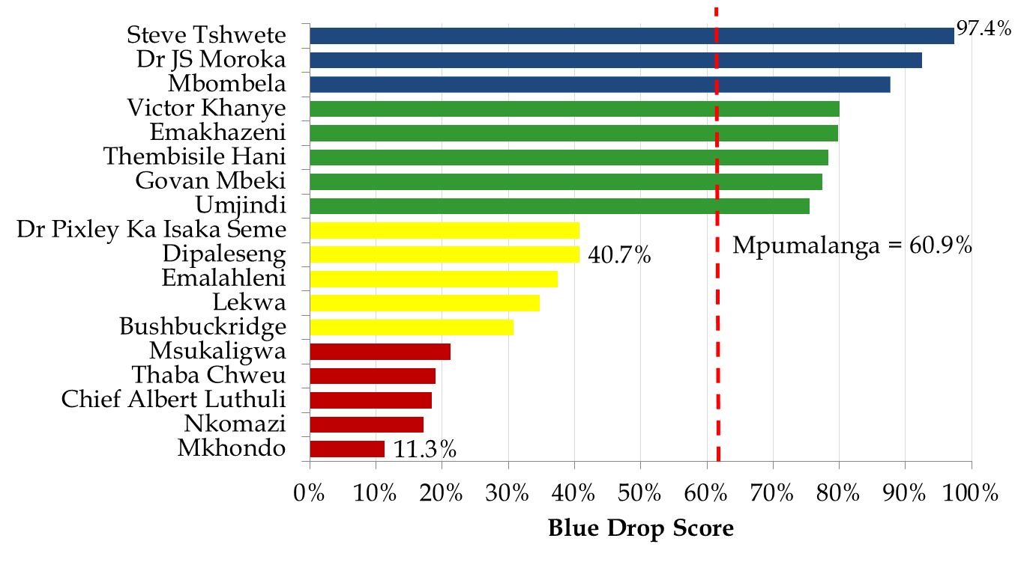
BLUE DROP REPORT (2012)
Excellent status
Good status
Very poor status
Critical status

Slide 48
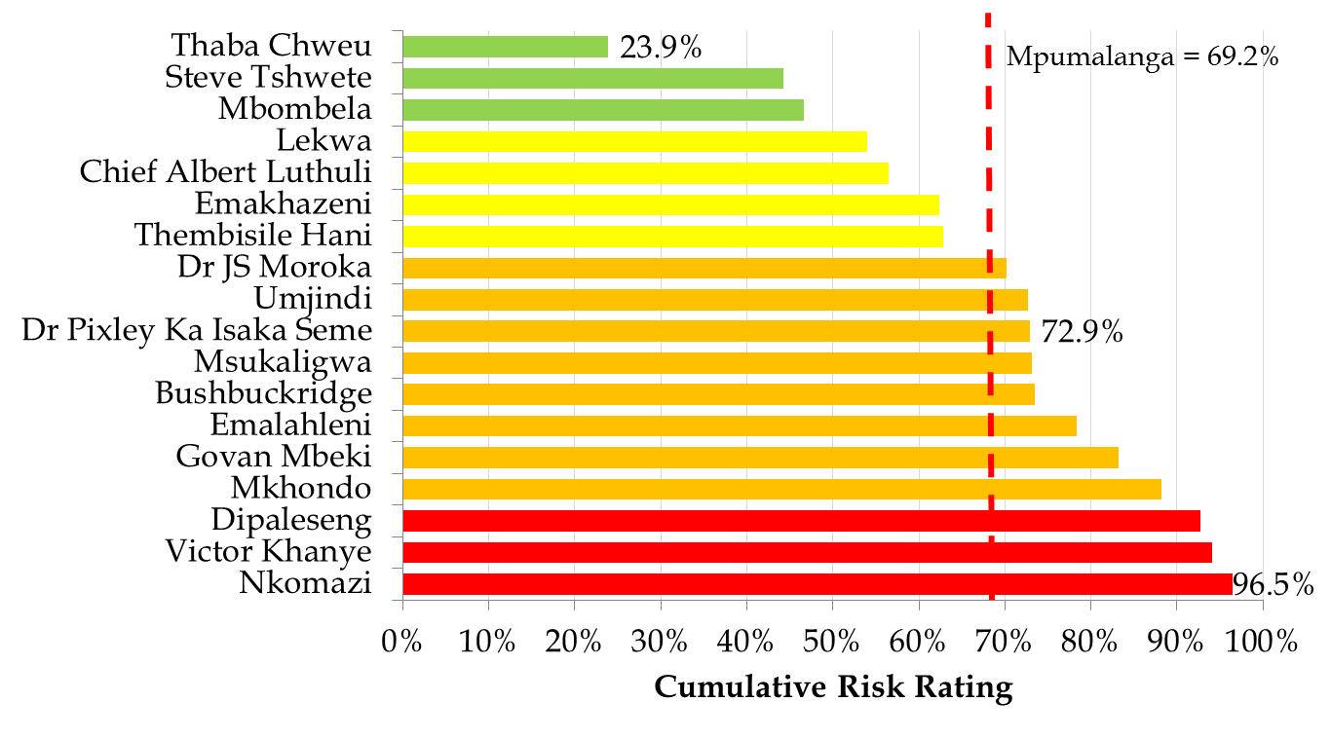
GREEN DROP REPORT (2012)
Critical risk
High risk
Medium risk
Low risk

Slide 49
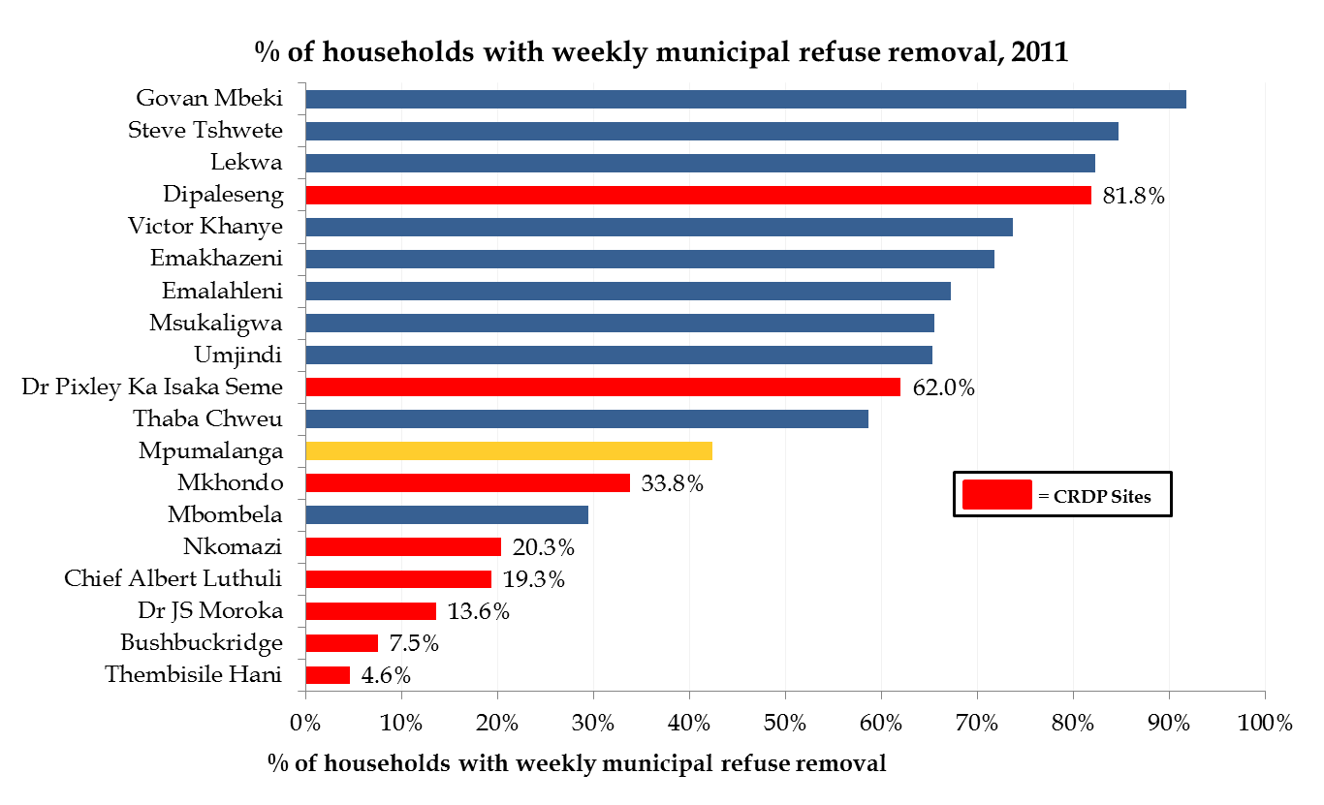
BASIC SERVICE DELIVERY - REFUSE REMOVAL

Slide 50
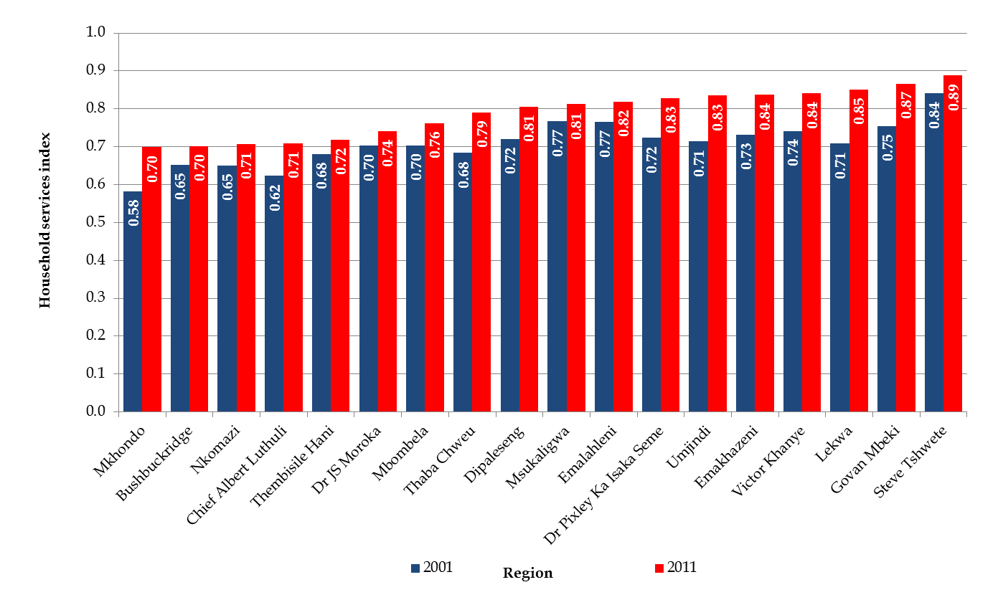
BASIC SERVICE DELIVERY
Household Services Index by Local municipal area, 2001 - 2011

Slide 51
HUMAN SETTLEMENTS
Expenditure/budget:
  Increased from R1.2 billion in 2010/11 to R1.8 billion this year – average increase of 10.7% pa
  4.9% of the MPG budget of R37 billion this year
Impact and challenges:
  Important role to address integrated human settlements and more specifically the informal housing backlog in the province
  Percentage of households in informal dwellings improved from 10.9% in 2011 (Census figure – backlog number almost 120 000 houses) to 8.2% in 2013 (General Household figure of StatsSA)
  High backlogs in terms of % of households in informal housing – Dipaleseng, Govan Mbeki, Lekwa, Thaba Chweu, Emalahleni, Victor Khanye, Steve Tshwete, Msukaligwa and Umjindi
  Should also take the population growth of municipal areas into account with planning & budgeting – especially high population growth areas such as Steve Tshwete, Emalahleni, Victor Khanye, Govan Mbeki, Umjindi and Mbombela (top 3 all from Nkangala and 4 urban areas all high population growth areas)

Slide 52
COGTA
Expenditure/budget:
  Increased from R390 million in 2010/11 to R473 million this year – average increase of only 4.9% pa (below the CPI)
  1.3% of the MPG budget of R37 billion this year
  Compensation of employees – three quarters of budget
Impact and challenges:
  Integrated municipal support - central role in assistance/support to Municipalities in terms of improving service delivery – back to the basics! Close cooperation and collaboration with other Departments such as Provincial Treasury – Municipalities should respond to the basic service delivery and socio-economic challenges of their respective localities/areas
  Importance of ensuring credible IDPs & LED strategies of Municipalities – capacity building of IDP & LED Managers
  Importance of increasing the LED status of Municipalities – ensuring functional LED Units, active & representative LED Forums, development and implementation of viable & relevant LED strategies responding to the socio-economic challenges of their respective localities/areas

Slide 53
NATIONAL TREASURY ALLOCATIONS, MPG EXPENDITURE & SASSA GRANTS
Local municipal area | National Treasury allocation |  | MPG expenditure 2013/14 | SASSA grants 2013/14
 | Equitable share 2013/14 | Infrastructure grant 2013/14
Chief Albert Luthuli | R171.5 million | R88.1 million | R1 084.8 million | R766.0 million
Msukaligwa | R109.0 million | R66.1 million | R750.0 million | R243.6 million
Mkhondo | R110.7 million | R69.1 million | R788.5 million | R371.2 million
Dr Pixley Ka Isaka Seme | R85.6 million | R30.6 million | R417.3 million | R131.6 million
Lekwa | R81.4 million | R43.5 million | R539.5 million | R167.8 million
Dipaleseng | R46.1 million | R20.6 million | R148.3 million | R81.9 million
Govan Mbeki | R191.1 million | R87.2 million | R1 063.7 million | R273.3 million
Victor Khanye | R54.2 million | R24.9 million | R424.8 million | R100.0 million
Emalahleni | R192.5 million | R102.1 million | R1 804.5 million | R639.5 million
Steve Tshwete | R92.6 million | R57.8 million | R972.3 million | R548.2 million
Emakhazeni | R38.5 million | R16.3 million | R436.1 million | R100.0 million
Thembisile Hani | R237.0 million | R109.3 million | R1 322.2 million | R441.5 million
Dr JS Moroka | R248.2 million | R115.1 million | R1 146.5 million | R773.0 million
Thaba Chweu | R81.2 million | R55.2 million | R562.8 million | R199.9 million
Mbombela | R342.2 million | R385.6 million | R3 040.3 million | R863.7 million
Umjindi | R52.3 million | R62.9 million | R393.6 million | R130.8 million
Nkomazi | R290.8 million | R220.5 million | R1 841.0 million | R826.8 million
Bushbuckridge | R485.3 million | R362.8 million | R3 008.8 million | R1 475.2 million

Slide 54
CRITICAL QUESTIONS – RESPONSES FROM MUNICIPALITIES
1. INVESTMENT AND BUSINESS | Responses
 | Poor | Average | Good
1.1 What is the perception by the public of the Municipality?
1.2 Investment-friendly environment in your municipal area?
1.3 What is the status of your investment strategy?
1.4 How is the relationship between Business & the Municipality?
1.5 Trust between Business & the Municipality?
1.6 Municipality part of a Business Forum?
1.7 Economic, financial & political stability in the municipal area?
1.8 Performing according to the economic potential of your area?

Slide 55
CRITICAL QUESTIONS – RESPONSES FROM MUNICIPALITIES
2. PLANNING, IDP & BUDGET | Responses
 | Poor | Average | Good
2.1 What is the status of cooperation/collaboration between the IDP Manager, CFO & MM?
2.2 How does your budget respond to your IDP?
2.3 How does your budget respond to the socio-economic challenges of your municipal area?
2.4 How does your budget respond to the triple challenges?
2.5 What is the status of cooperation/collaboration with Provincial Departments?
2.6 Spatial planning and development and in line with municipal SDF?
2.7 Long term & strategic plans at/in the Municipality?
2.8 What is the status of youth development strategies and plans at/in the Municipality?

Slide 56
CRITICAL QUESTIONS – RESPONSES FROM MUNICIPALITIES
LOCAL ECONOMIC DEVELOPMENT | Responses
 | Poor | Average | Good
3.1 Functional (operational & viable) LED Unit/Manager?
3.2 What is the status of cooperation/collaboration between the LED Manager, MM and Mayor?
3.3 What is the status of the LED Forum?
3.4 What is the status of the development of a LED strategy?
3.5 LED strategy incorporates economic interventions from Provincial Departments?
3.6 What is the status of the implementation of the LED strategy?
3.7 Developing industries in the municipal area to increase economic growth and with a high labour absorption?
3.8 What is the status of Monitoring & Evaluation (M & E) with regard to LED in the Municipality?

Slide 57
CRITICAL QUESTIONS – RESPONSES FROM MUNICIPALITIES
Municipal Area | Investment & Business | Planning, IDP & Budget | LED
Gert Sibande
Chief Albert Luthuli
Msukaligwa
Mkhondo
Dr Pixley Ka Isaka Seme
Lekwa
Dipaleseng
Govan Mbeki
Nkangala
Victor Khanye
Emalahleni
Steve Tshwete
Emakhazeni
Thembisile Hani
Dr JS Moroka
Ehlanzeni
Thaba Chweu
Mbombela
Umjindi
Nkomazi
Bushbuckridge

Slide 58
ANALYSIS
Investment and Business questions and status of Municipalities – concern about the status (poor) of Chief Albert Luthuli, Lekwa, Dipaleseng, Emalahleni and Bushbuckridge – status of Nkangala DM as well as Steve Tshwete, Emakhazeni and Mbombela good
Planning, IDP and Budget questions and status of Municipalities – Poor status of especially Dr JS Moroka a concern – Gert Sibande and Nkangala District Municipalities recorded a status of good in this regard as well as Msukaligwa, Dr Pixley Ka Isaka Seme and Steve Tshwete
Most of the Municipalities are experiencing challenges in terms of LED – especially on active LED Forums and the development & implementation of LED strategies
6 Municipalities described their status in terms of LED as good – 3 of that are from Ehlanzeni including the District Municipality as well as Mbombela and Nkomazi
Clear from the responses of the Municipalities that they need support from Provincial Government on LED

Slide 59
LED - KEY ACTIONS
LED workshops per District by LED Units of COGTA & DEDT and also Economic Analysis Unit of Finance
Establishment of LED committees/working groups per District
Development of LED support plans per District in cooperation/collaboration with LED Manager of each District and in line with Municipalities’ LED status & needs
Ensuring functional LED Units and active, vibrant & representative LED Forums at all Municipalities
Development and/or review of LED strategies
Integrated and coordinated support with the implementation of LED strategies including economic interventions advice & support
Capacity building programmes on LED for Officials and Councillors of Municipalities

Slide 60
EDUCATION
Expenditure/budget:
  Increased from R10.9 billion in 2009/10 to R16.3 billion this year – average increase of 10.6% pa – COE almost 80% of the budget!
  44.1% of the MPG budget of R37 billion this year!
  Infrastructure expenditure increased from R435 million in 2010/11 to R1 billion in 2014/15
Impact and challenges:
  No schooling – people 20+ improving to 10.8% in 2013, but worst among the 9 provinces & higher than national average of 5.6%
  Adult literacy rate – improved to 88% in 2013, but joint second lowest in SA & lower than 92.9% national average
  ANA – NDP target, 90% of learners in grade 3, 6 & 9 must achieve 50% or more in ANA – challenges especially with Mathematics – average % mark for grade 9 in 2013 only 13.7% and only 1.6% of learners 50%+

Slide 61
EDUCATION
Impact and challenges:
  People 20+ with matric – 26.6% in 2013 & 4th highest among the provinces, but lower than national rate of 92.9%
  Matric pass rate – improved from the lowest (47.9%) in 2009 among the provinces to the 5th highest (77.6%) in 2013
  Matric pass rates of Accounting relatively low and below 60% in 2013 (56.1%), Mathematics (58.3%) and Economics (58.9%) - also lower than national averages for these 3 subjects
  Admission to Bachelor studies – improvement to 25.9% in 2013, but still relatively low
  Throughput (learners completing school within 12 years) rate – less than 60% – high drop out figures between grade 10 and 12
  Grade 10-12 repetition rates relatively high – grade 11 rate = 31.7%, the highest in SA last year
  Pass rates per municipal area – only 1 area with a matric pass rate less than 70% last year, Dr Pixley ka Isaka Seme (68.1%) and only 1 area’s pass rate declined, Emakhazeni!

Slide 62
EDUCATION
Impact and challenges:
  1 052 807 learners in public & independent schools in Mpumalanga in 2013, attended 1,885 schools and served by 34,936 educators/teachers
  Learner-educator/teacher ratio (public schools) - improved from 33.5 in 2005 to 30.7 in 2013 – slightly higher than national average
  Learner-school ratio – increased from 479 in 2005 to 580 in 2013, higher than national average of 496
  Educator/teacher-school ratio – increased from 14 in 2005 to 19 in 2013 – higher than national average of 16 teachers per school
  School nutrition programme – 83.2% of children attending public schools benefitted from the programme in 2013
  Early Childhood Development (ECD) – improvement between 2012 & 2013 – 30.7% of the provincial population aged 0-4 attended an ECD centre last year - lower than national average of 34.4 per cent
  Education improving skills in line with the needs of the provincial labour market? Role and impact of MRTT? Role of the University of Mpumalanga in the future – close cooperation with Department of Higher Education!

Slide 63
EDUCATION
Comparison of Grade 12 pass rates and admission to further studies by Local Municipal Area, 2013
Local municipal area | Pass rate | Admission to:
 |  | Higher Certificate studies | Diploma studies | Bachelor studies
Nkomazi | 85.6% | 17.3% | 36.2% | 32.1%
Steve Tshwete | 84.5% | 12.2% | 38.0% | 34.4%
Emalahleni | 83.2% | 16.8% | 38.5% | 27.9%
Victor Khanye | 82.9% | 19.8% | 37.4% | 25.7%
Mbombela | 81.1% | 17.1% | 31.3% | 32.5%
Chief Albert Luthuli | 79.4% | 17.3% | 32.7% | 29.4%
Lekwa | 78.5% | 17.0% | 31.5% | 30.1%
Umjindi | 77.5% | 16.3% | 34.3% | 26.8%
Govan Mbeki | 77.1% | 16.2% | 34.0% | 26.9%
Msukaligwa | 75.9% | 19.1% | 29.5% | 27.3%
Thaba Chweu | 75.8% | 13.3% | 31.1% | 31.4%
Dr JS Moroka | 74.0% | 22.6% | 29.1% | 22.3%
Mkhondo | 73.7% | 16.4% | 28.8% | 28.5%
Thembisile Hani | 73.0% | 19.6% | 35.4% | 18.0%
Dipaleseng | 72.6% | 17.5% | 36.8% | 18.4%
Bushbuckridge | 71.7% | 23.9% | 30.4% | 17.3%
Emakhazeni | 71.3% | 23.8% | 31.6% | 16.0%
Dr Pixley ka Isaka Seme | 68.1% | 19.7% | 28.4% | 20.0%
Mpumalanga | 77.6% | 19.0% | 32.7% | 25.9%

Slide 64
IMPROVING EDUCATION
MPG Expenditure on Education* |  | Impact |  |  |  | Vision 2030 Target
Value R billion | Average annual % increase | Indicator | 2009 (or earliest available) | 2013 | Trend | 2030
2009/10 R10.9 billion 2014/15 R16.3 billion (44.1% of MPG budget) 6-year Total R81 billion | 8.1% | ANA results % of Gr 3, 6 & 9 learners that achieve ≥ 50% in: Mathematics = M | 2012 Gr 3 M=25% Gr 6 M=6% Gr 9 M=1% | Gr 3 M=46% Gr 6 M=16% Gr 9 M=2% |  | 90% of learners in grades 3, 6 & 9 must achieve, in both L & M, ≥ 50%
 |  | Throughput rate | 2010 61.5% | Less than 60% |  | Improve throughput rate of learners to at least 80%
 |  | Grade 12 pass rate | 2009 47.9% | 77.6% |  | At least 80% of above mentioned learners should pass exit exams
 |  | Bachelor admission rate | 2009 12.1% | 25.9% |  | -
Note: * Actual expenditure from 2009/10 to 2013/14 and budget for 2014/15 (EPRE, 2014)
Sources: Department of Basic Education and Mpumalanga Department of Education
Trend: green = improve and red = deteriorate

Slide 65
IMPROVE EDUCATION OUTCOMES
Strict unemployment rate by specific levels of education
Level of education | Unemployment rate Q3 2014
Matric completed | 33.9%
Matric & certificate completed | 21.7%
Matric & diploma completed | 9.4%
Matric & degree+ completed | 7.5%
19.0% of 2013 matriculants obtained admission to higher certificate studies
32.7% of 2013 matriculants obtained admission to diploma studies
25.9 % of 2013 matriculants obtained admission to bachelor studies

Slide 66
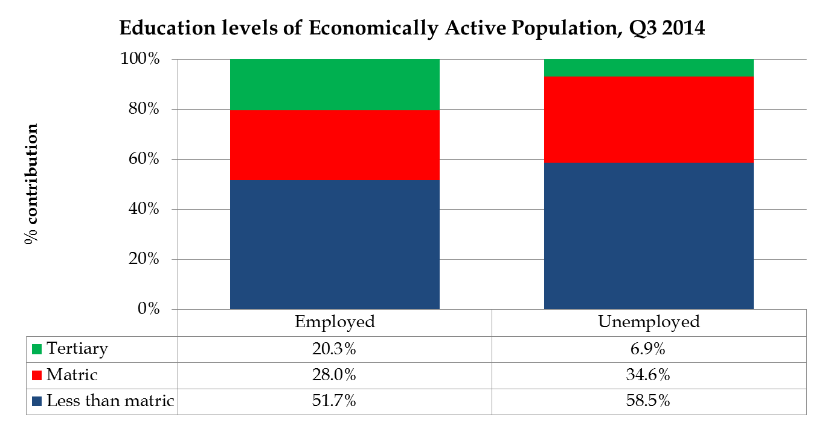
IMPROVE EDUCATION OUTCOMES

Slide 67
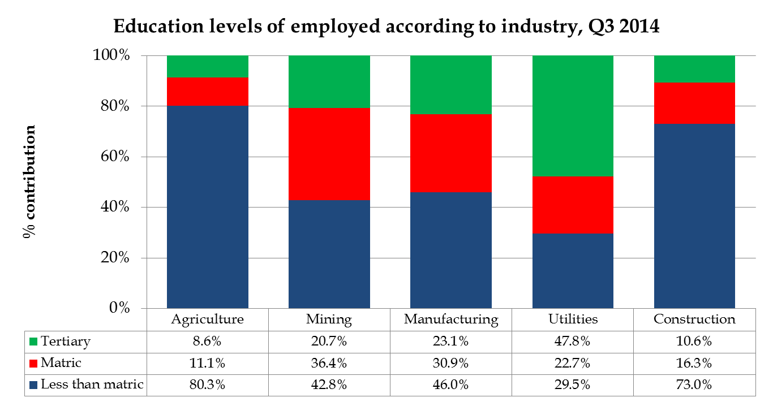
IMPROVE EDUCATION OUTCOMES

Slide 68
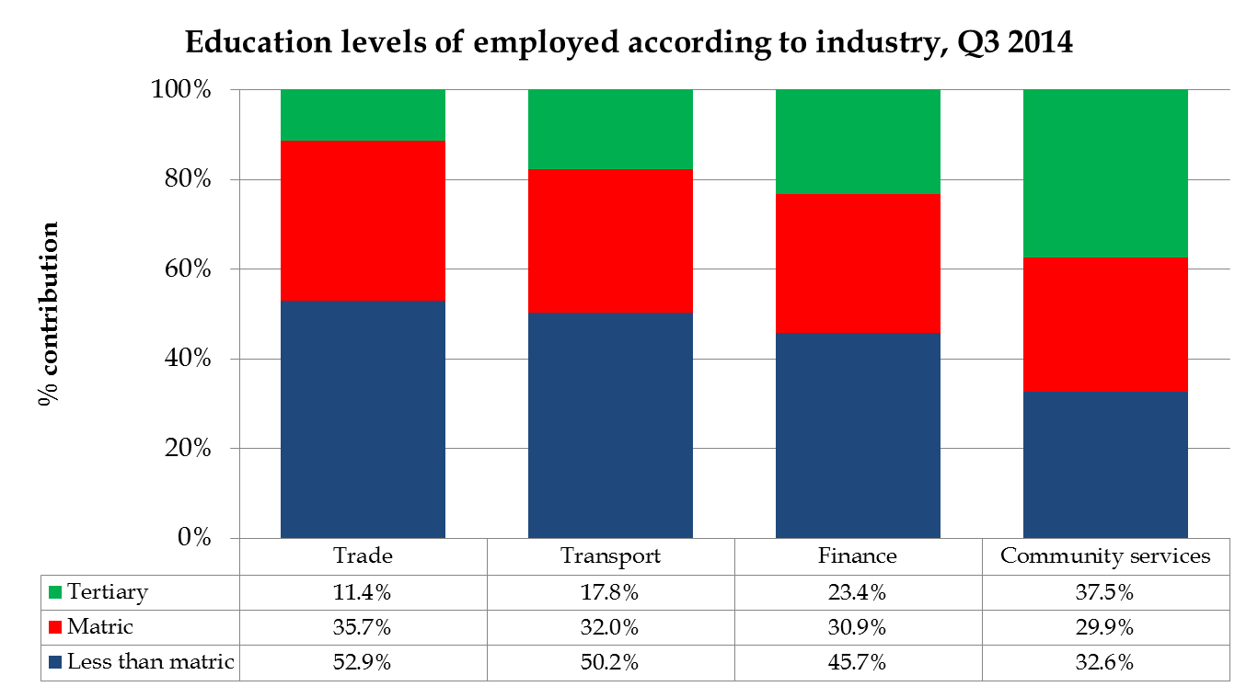
IMPROVE EDUCATION OUTCOMES

Slide 69
HEALTH
Expenditure/budget:
  Increased from R5.8 billion in 2009/10 to R9 billion this year – average increase of 9.2% pa – COE almost two thirds of the budget!
  24.3% of the MPG budget of R37 billion this year!
  Infrastructure expenditure increased from R497 million in 2010/11 to R627 million in 2014/15 – average increase of 6% pa
Impact and challenges:
  HIV prevalence rate (females aged 15-49) for Mpumalanga - 35.6% in 2012 (latest available figure) – second highest after KZN & higher than the national average of 29.5%, but declining with more than 1% point between 2011 & 2012 (according to the National Department of Health)
  Gert Sibande rate 40.5% in 2012 - highest of 3 districts in Mpumalanga and second highest of health districts in South Africa, but declining from 46.1% (highest) in 2011 – Ehlanzeni 12th & Nkangala 20th highest/worst of the 52 health districts nationally in 2012 (National DoH)
  50% of MP’s municipal areas a HIV prevalence rate of 40% plus in 2012 – highest rate in Steve Tshwete and lowest in Dr JS Moroka according to Mpumalanga Department of Health

Slide 70
HEALTH
Impact and challenges:
  Improving trend with provincial life expectancy but far below 70 year target of NDP & Provincial Vision 2030 – TB cure rate also improved slightly between 2009 and 2012
  Importance of special interventions with the deterioration of the inpatient death (under 1) rate as well as the immunization coverage under 1 year!
  Importance to spend budget in the right health areas to maximize impact on provincial citizens!

Slide 71
IMPROVING HEALTCARE
MPG Expenditure on Healthcare* |  | Impact |  |  |  | Vision 2030 Target
Value R billion | Average annual % increase | Indicator | 2009 (or earliest available) | Latest available figures | Trend | 2030
2009/10 R5.8 billion 2014/15 R9 billion (24.3% of MPG budget) 6-year Total R44 billion | 9.2% | HIV prevalence rate – antenatal clients tested | 34.7% | 2012 35.6% |  | -
 |  | TB cure rate (new smear positive cases) | 73.1% | 2012 77.0% |  | -
 |  | Immunisation coverage < 1 year (annualised) | 74.1% | 2013 70.9% |  | -
 |  | Inpatient death (under 1) rate | 8.8% | 2013 9.8% |  | -
 |  | Life expectancy | 2006-11 Males = 51.5 yr Females = 55.5 yr | 2011-16 Males = 56.9 yr Females = 60.1 yr |  | Improve male and female life expectancy at birth to 70 years
Note: * Actual expenditure from 2009/10 to 2013/14 and budget for 2014/15
Sources: National & Provincial DoH and Statistics South Africa’s Mid-Year Estimates

Slide 72
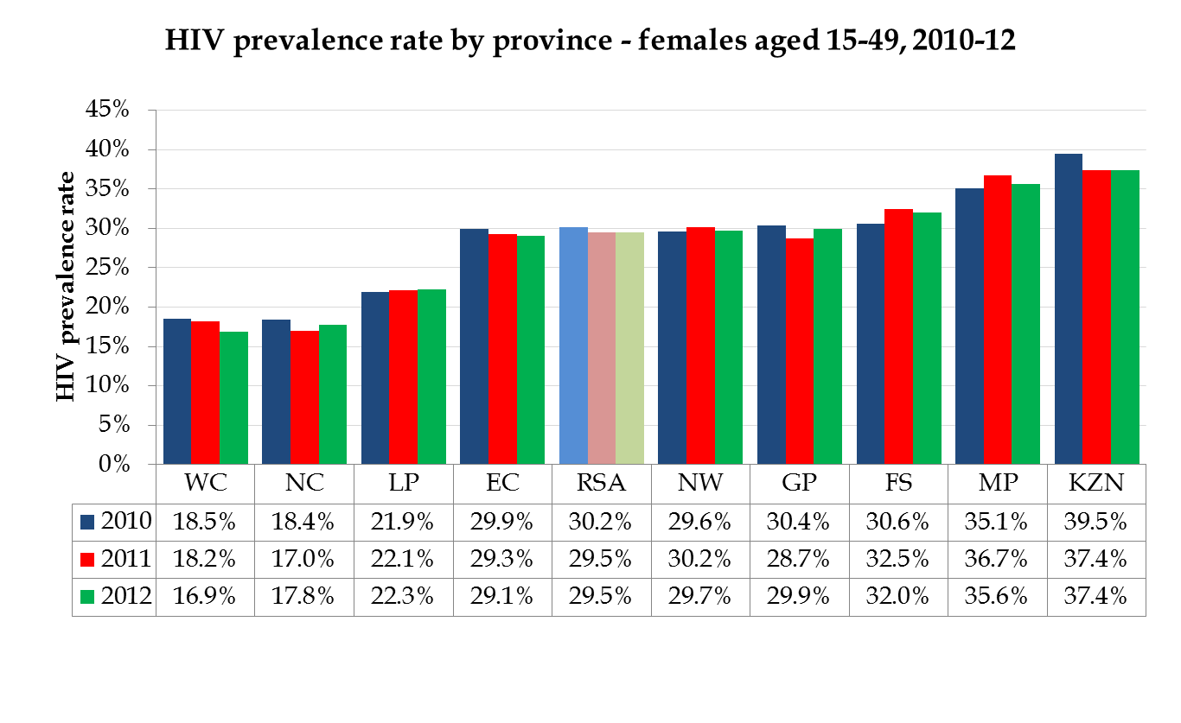
HIV PREVALENCE

Slide 73
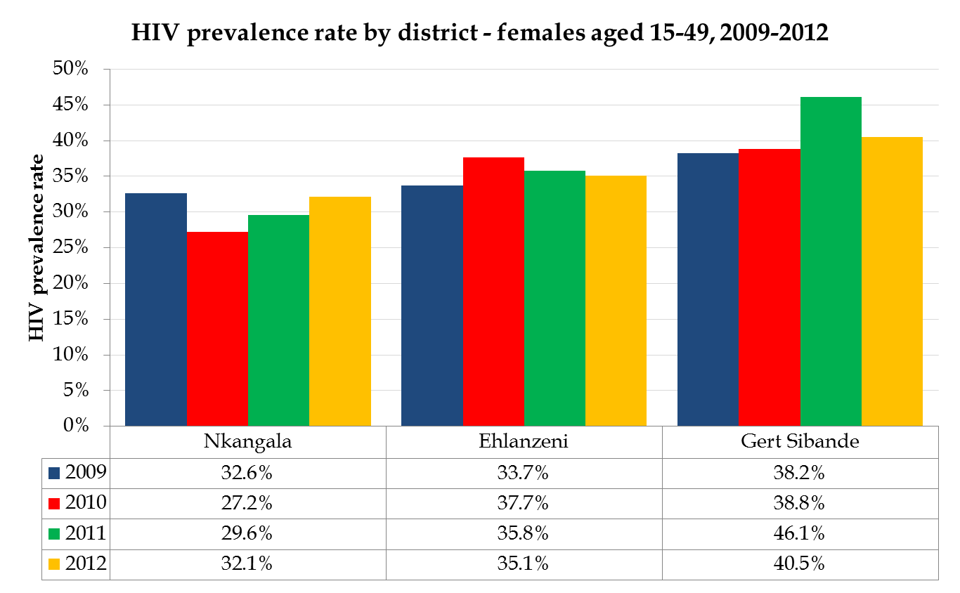
HIV PREVALENCE

Slide 74
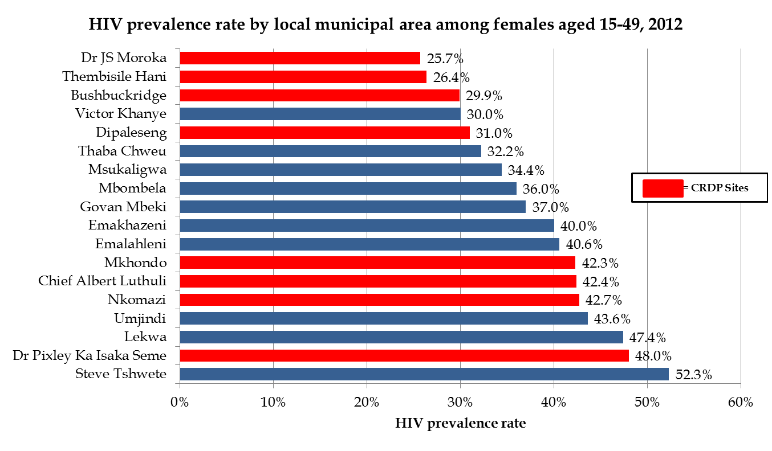
HIV PREVALENCE

Slide 75
CHALLENGES & CRITICAL QUESTIONS
Growth challenge – negative impact of international & national economy and structural challenges, provincial economic drivers such as mining & manufacturing not performing well, importance of the development of other industries such as agriculture and tourism with a high labour absorption, important role of MTPA – addressing energy and skills contraints etc
Importance of investment to stimulate growth – clear provincial investment strategy and also on district and municipal level? Role of MEGA?
Importance of cooperation/collaboration and partnerships with the private sector – importance and relevance of LED/RED to increase growth, economic interventions from DEDT – looking at different funding models for development projects
Job creation challenge – focus on the youth, questions about the sustainability of CRDP & EPWP jobs, importance of job tracking, SMME development, questions about Cooperatives?
HIV challenge – impact of interventions from DoH?
Good progress with basic education but still some challenges with ANA, Mathematics, througput rate, quality of grade 12 certificate etc, questions about skills and more specifically relevant skills for the labour market
Back to the basics with basic service delivery! Important for investment!
Importance of evidence-based research & decision making in Government!

Slide 76
Thank you

